Slide 1

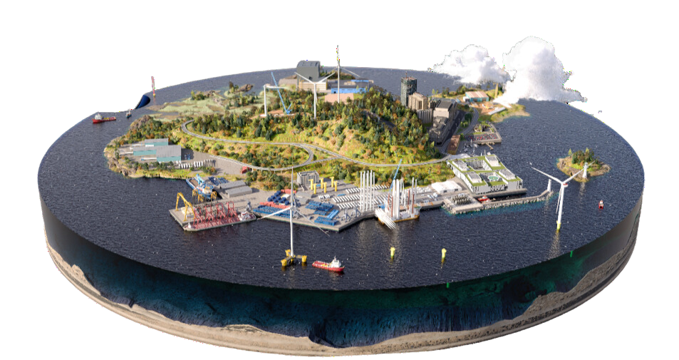








Find your next business opportunity -
explore Denmark’s wind value chain
In Denmark, the entire wind value chain is present and consists of a close-knit network of collaborating companies, research institutions and public players. Explore the digital visualisation of Denmark’s wind value chain and discover companies and organisations that specialise in wind-related technology, services and solutions to find your next business partner.
RD & D
Go explore!
PROJECT AND SITE OPERATIONS
DECOMMISSIONING AND AFTERLIFE
COMPONENT PRODUCTION
INSTALLATION
POST INSTALLATION
greenvaluechains.com

Slide 2

Why use the digital value chain tool?
Get an overview of the companies working in the wind sector in Denmark
Get an understanding of each company’s expertise
Find the relevant business partner for your activities
Get contact details and initiate dialogue
RD & D
PROJECT AND SITE OPERATIONS
DECOMMISSIONING AND AFTERLIFE
COMPONENT PRODUCTION
INSTALLATION
POST INSTALLATION
Go explore!
greenvaluechains.com

