Slide 1
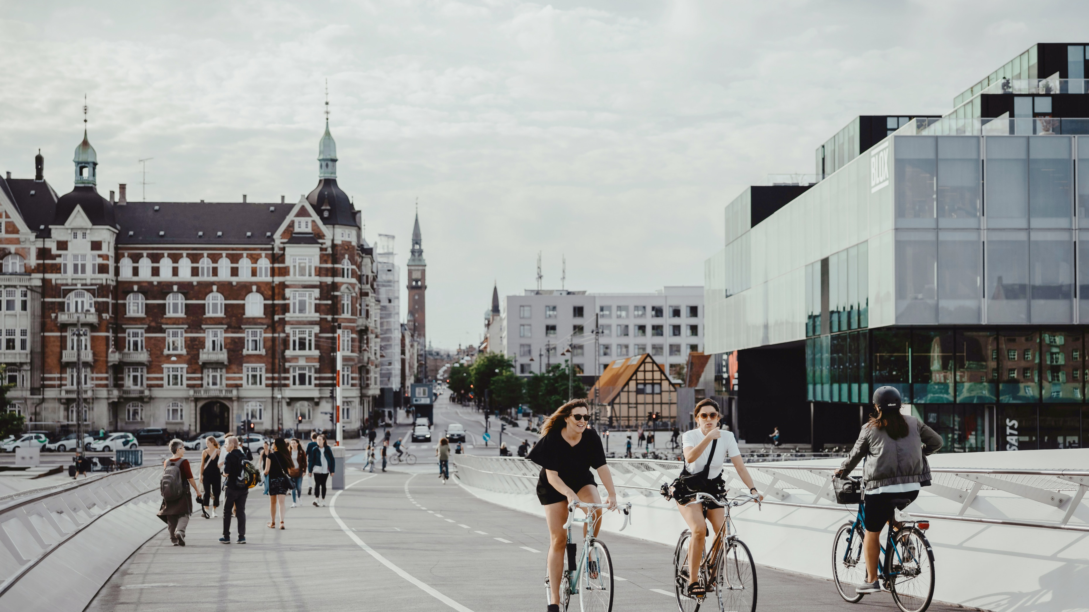
Turning holistic sustainability goals into practical building solutions
Julie Kjestrup, Head of Policy and Thought Leadership, VELUX
State of Green webinar 18th September
Theory: Healthy Homes Barometer 2024
Practice: Living Places
Notes:
Thank you

Slide 2
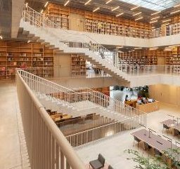
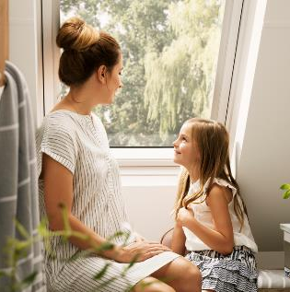
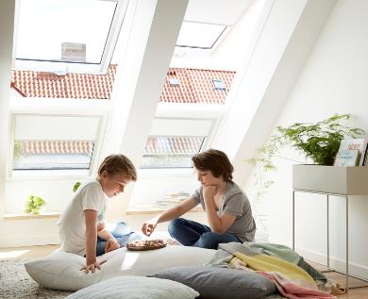
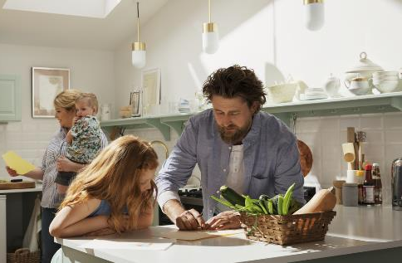
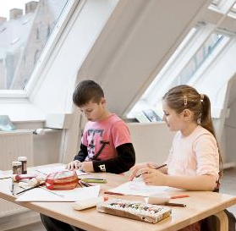
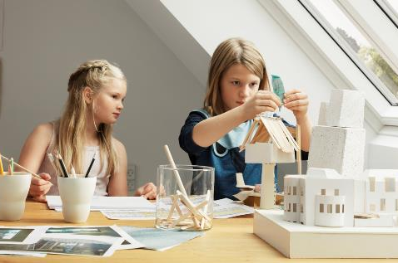
We create well-being
for people
and planet by transforming spaces using daylight and fresh air
Notes:
Bringing daylight and fresh air into homes around the world for more than 80 years.
Our products help create bright, healthy and energy-efficient places in which to live, work, learn and play.
We started our journey with sustainable living in buildings in 1999. Since then have been involved in more than 30 full-scale demonstration building projects in 22 countries and driven research that puts the spotlight on the need for building renovation solutions to address societal and environmental issues.
In all projects we emphasise the health and well-being of the users of buildings alongside environmental and energetic concerns

Slide 3

Healthy Buildings Barometer 2024
.
How to deliver healthy, sustainable, and resilient buildings for people
What
The latest in a series that track the state of European buildings to shine a light on how the European building stock can better benefit people, society and the planet.
BPIE researched and wrote the report
Why
Healthy buildings should be the only kind of buildings in which people live, learn, work, play or recover.
Today, one in four Europeans live in buildings where indoor air quality falls below national standards.
Ensuring all Europeans have access to healthy buildings should be a political priority
How
By substantiating and measuring the benefits of healthy buildings as part of an overall, holistic approach and provide a concrete path forward with a set of recommendations ready to apply as part of EPBD implementation
Notes:
At VELUX, we started our journey with sustainable living in buildings in 1999. Since then have been involved in more than 30 full-scale demonstration building projects in 22 countries and driven research that puts the spotlight on the need for building renovation solutions to address societal and environmental issues.
In all projects we emphasise the health and well-being of the users of buildings alongside environmental and energetic concerns.
We do that because we believe that healthy buildings should be the only kind of buildings in which people live, learn, work, play or recover
that brings us onto the report we’re launching today, the Healthy Buildings Barometer 2024
We produced the first report back in 2015, and this is the 8th edition
Eagle eyed reader will notice that this year’s report has changed name from Healthy Homes to Healthy Buildings: That’s because we’ve expanded the scope to cover all major buildings: homes, workplaces, schools and hospitals
but the overall goal remains the same: to shine a light on how the European building stock can better benefit people, society and the planet
The average person in the northern hemisphere spends some 90% of their time indoors, yet traditionally there has been a lot more interest in and focus on the outside air quality
we wanted to help remedy this by quantifying the size of the problem both in numbers, and financial figures, and what we can derive as a society from rectifying it.
The good or bad news is that there is a lot to do – but we have the tools to do it. To give one example: One in four Europeans live in buildings where indoor air quality falls below national standards.
What we want to do with this report is to substantiate and measure the benefits of healthy buildings as part of an overall, holistic approach and provide a concrete path forward with a set of recommendations
Very thankful for the excellent partnership with BPIE who analysed and wrote the report for us.

Slide 4
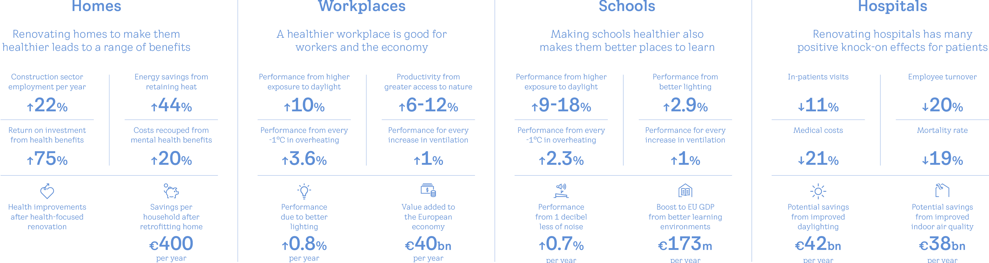
Why does it matter?
Benefits of healthy buildings for the EU across four building types
Notes:
[FLEMING]
Busy slide – we won’t go through all
Allow me to highlight a few figures in terms of what we can gain from investing in healthier people through healthier, more sustainable buildings.
Overall:
A huge number of new construction jobs - between 200.000-500.000 more jobs at EU level if we start renovation efforts across EU.
Workplaces:
increased performance from higher access to day light, nature, and comfortable temperatures – overall, value add 40 bn per year to European economy
the same trends for schools
Hospitals:
significantly lower employee turn-over and better outcomes for patients: less mortality, less medical costs, less in-patient visits

Slide 5
The EU is not on track
EU Data highlights
3%
Renovation rate
recommended
Investments in renovation is insufficient
+1400%
-40%
required
0.2%
In 2019
1 in 4
30m citizens
Europeans live in buildings where
+18%
Indoor air quality falls
Affected by
insufficient daylight in their homes
CO₂ emissions
Notes:
[FLEMING]
A few more figures before we dive into the key findings of the report:
Accumulated investments in renovations in 2020 were 40% lower than required to reach EU goals
30 million Europeans affected by insufficient daylight in their homes
Perhaps most shocking: 0.2% average annual deep renovation rate in 2019 vs 3% recommended annual renovation rate. A boost of 1400% is required.
To put this into perspective: this means that renovation rates should pretty much increase by a factor of almost 15 times.

Slide 6
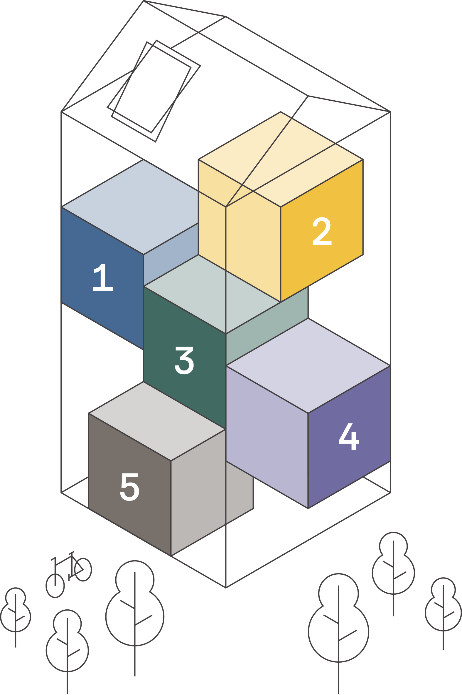
A holistic framework that puts people first
The HBB 2024 framework
Five interrelated dimensions of healthy buildings
Designed for human needs
Improving mental and physical health
Resilient and adaptive
Sustainably built and managed
Empowering people
Notes:
[FLEMING]
To guide EU policymakers on what makes a building healthy, sustainable and resilient, the HBB establishes a landmark new framework based on sound scientific research and illustrated through 12 case studies from across Europe.
The framework is based on five interrelated dimensions with the following characteristics and objectives: 1) improve mental and physical health, 2) designed for human needs, 3) sustainably built and managed, 4) resilient and adaptive, and 5) empowering people.
Each dimension is composed of a set of indicators, with a total of 24 indicators, guiding stakeholders in their decision-making process to achieve truly healthy, sustainable and resilient buildings.

Slide 7
Focus on five areas of action
Policy recommendations
1
2
3
4
5
Broaden the regulatory focus to include the concept of healthy buildings and occupants.
Ensure access
to data
so that the buildings’ health, sustainability, and resilience can be tracked over time.
Increase cross-functional collaboration
and information-sharing between actors within and outside the construction sector.
Use decision-making tools effectively
for an integrated focus on sustainability, and resilience of buildings.
Put people
at the centre
and involve them throughout the lifecycle of buildings.
Notes:
[FLEMING]
It’s easy to theorise – therefore have included actual examples in report, and even more on microsite
The case studies presented here are real building projects, assessed using the new Healthy Buildings Barometer framework.
They represent different countries, climate zones and types of buildings. Some are new build, others renovation
They illustrate that while healthy buildings are the exception across the EU as it stands, we can realise sustainability, resilience, and affordability simultaneously.
And that across residential, public, and commercial buildings, innovative and different approaches are possible and achievable

Slide 8
Healthy buildings in practice
.
Sweden
Case study: Kvartetten office complex
The Netherlands
Case studies: Nijverdal social housing apartments & new city hall
Denmark
Case studies: Langebjerg School &
Living Places Prototype
Belgium
Case study: Anderlecht social housing
France
Case studies: Malakoff raise-the-roof apartments & Marcey-les-Grèves kindergarden extension
Slovakia
Case study: Sala single-family home
Spain
Case study: Valladolid market
Germany
Case studies: Dortmannhof & Hammelburg Musikakademie
Notes:
[FLEMING]
It’s easy to theorise – therefore have included actual examples in report, and even more on microsite
The case studies presented here are real building projects, assessed using the new Healthy Buildings Barometer framework.
They represent different countries, climate zones and types of buildings. Some are new build, others renovation
They illustrate that while healthy buildings are the exception across the EU as it stands, we can realise sustainability, resilience, and affordability simultaneously.
And that across residential, public, and commercial buildings, innovative and different approaches are possible and achievable

Slide 9


Build for Life
How we build and transform buildings today has an enormous impact on people and communities, as well as the ecosystems that sustain us tomorrow.
Extraction
Production
Construction
Use
Renovation
End of life
Beyond
Notes:
Main script:
The way we build today has an enormous impact on people, and the ecosystems that sustain us.
At VELUX, we’re taking action through Build for Life – a pioneering, multidisciplinary initiative that reconnects people and the planet through healthier, more sustainable buildings.
Additional information:
https://buildforlife.velux.com/

Slide 10
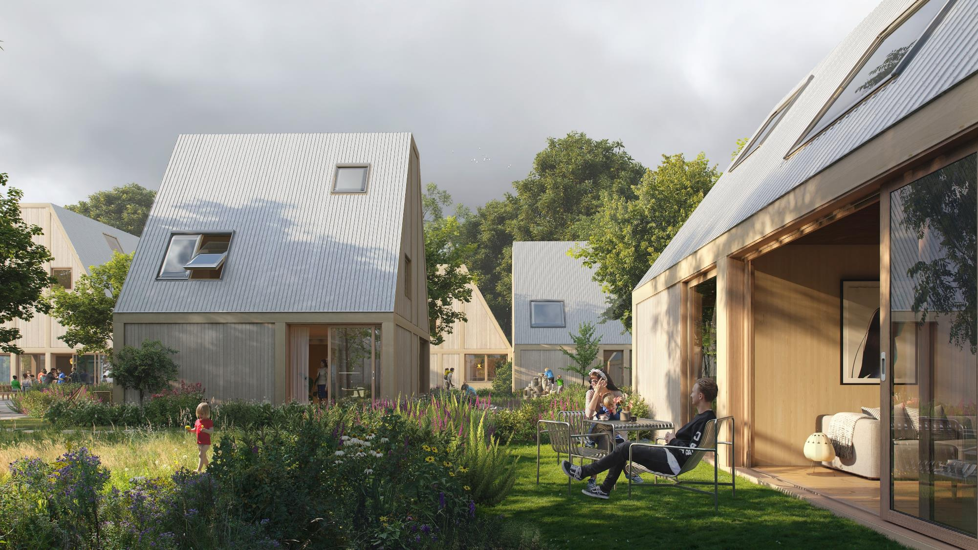
Living Places
More sustainable living environments for
people and planet.
Notes:
Main script:
With Living Places, we want to inspire – and prove that change is possible right now.
Based on five key principles which can be applied to any home, community or city, we want to create homes that are scalable, affordable and commercially viable.
The 5 principles are:
HEALTHY
What if we could build homes that are healthy for both people and the planet?
SHARED
What if we could strengthen our sense of community by rethinking how we live?
SIMPLE
What if a new way of building can enable easy upgrades and a longer lifespan?
ADAPTIVE
What if we can create homes that respond to more ways of living?
SCALABLE
What if by rethinking the way we design, plan and finance homes, we could unlock housing for the many?

Slide 11
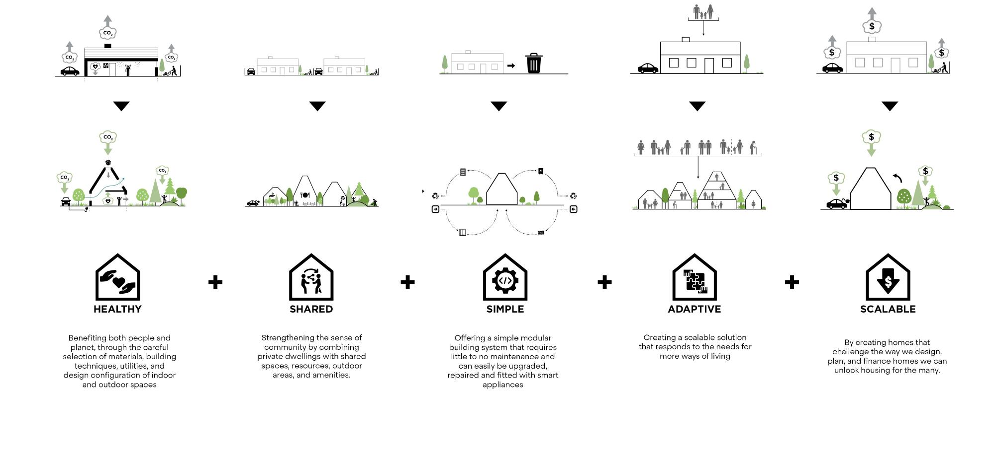
Principles for
Living Places
Notes:
Main script:
With Living Places, we want to inspire – and prove that change is possible right now.
Based on five key principles which can be applied to any home, community or city, we want to create homes that are scalable, affordable and commercially viable.
The 5 principles are:
HEALTHY
What if we could build homes that are healthy for both people and the planet?
SHARED
What if we could strengthen our sense of community by rethinking how we live?
SIMPLE
What if a new way of building can enable easy upgrades and a longer lifespan?
ADAPTIVE
What if we can create homes that respond to more ways of living?
SCALABLE
What if by rethinking the way we design, plan and finance homes, we could unlock housing for the many?

Slide 12
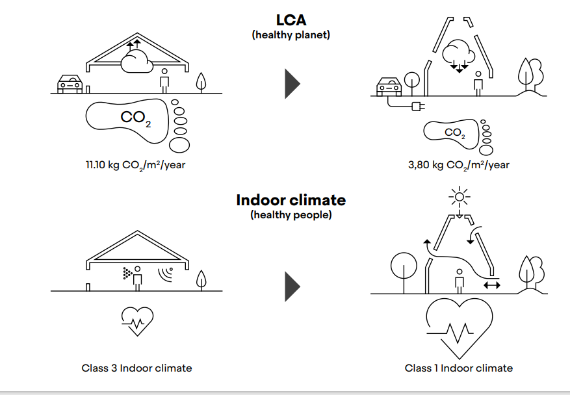
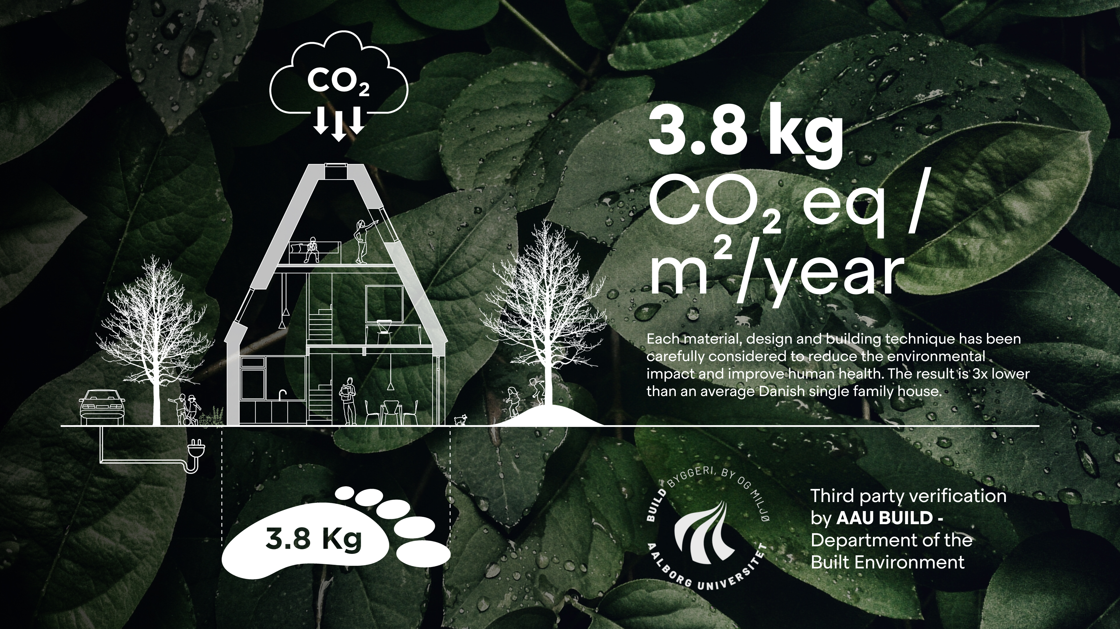
3x lower carbon footprint & healthy indoor climate
Notes:
Main script:
We took a look at the average Danish home. We examined materials, construction, utilities, and architecture. Then we asked ourselves how rethinking everything can take us closer to building homes with significantly less impact on the planet.
The result is Living Places: a collection of truly sustainable homes with a carbon footprint 3x lower than an average Danish home.
We already have all the knowledge and solutions we need to create people-positive, low-emission housing for the many. In fact, we’re ready to build this way right now. It’s just about getting started.

Slide 13
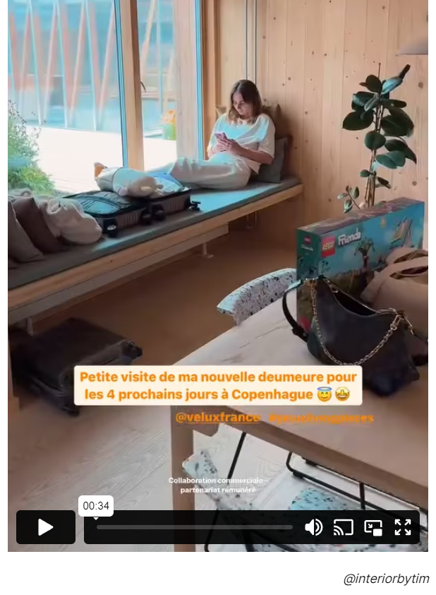
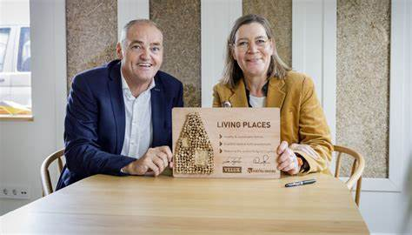
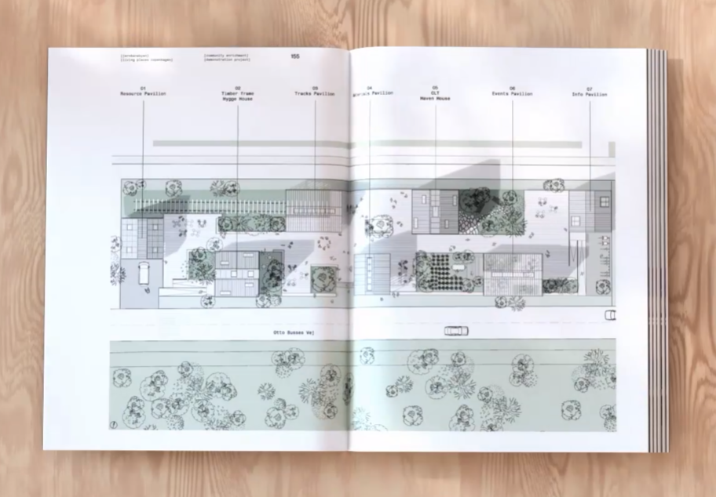
Beyond a prototype
First partnership agreement with Bouwgroup Dijkstra (NL)
Children’s Living Places in Ukraine with SOS Children’s Villages
Living Places Book explaining the 'recipes’
Living Places Living to collect ‘lived in’ data

Slide 14
Julie Kjestrup, Head of Policy and Thought Leadership
Julie.Kjestrup@velux.com
www.velux.com

