Slide 1
RETHINKING CITIES Roadmap for Global Climate Action
Kathrine Wehrs
Project Manager for The Climate Alliance, C40 Cities Climate Leadership Group
Webinar: Collaborative urban transformation
September 2024

Slide 2
C40 is a network of mayors of nearly 100 world-leading cities collaborating to deliver the urgent action needed right now to confront the climate crisis. Together, we can create a future where everyone, everywhere can thrive.
© C40

Slide 3
The C40 Cities network
Directly representing almost 600 million residents
Influencing approximately 920 million people living and working in the wider city

Slide 4
Mayors of C40 cities are committed to using an inclusive, science-based and truly collaborative approach to help the world limit global heating to 1.5°C and build healthy, equitable and resilient communities.
© Orbon Alija / Getty Images

Slide 5
What we do
C40 and our mayors are driving a green and just recovery from COVID-19 and are supporting cities to cut their fair share of emissions in half by 2030. We do this by:
Raising climate ambition, through 1.5°C climate action plans, high-impact accelerators, the Cities Race to Zero programme and innovation.
Building equitable and thriving communities, through our Inclusive Climate Action and Thriving Cities programmes.
Building a global movement, through robust international diplomacy, advocacy and coalition-building with all sectors of society.
Scaling up climate action and sharing best practice across key, high-impact sectors.
Facilitating access to finance for climate breakdown mitigation and resilience projects in cities.

Slide 6
2021-24 Leadership Standards
1. PLAN City has adopted a resilient and inclusive climate action plan, aligned with the 1.5˚C ambition of the Paris Agreement, and updates it regularly.
2. DELIVER City remains on track in 2024 to deliver its climate action plan, contributing to increased resilience, equitable outcomes and halving overall emissions by 2030.
3. MAINSTREAM City uses the necessary financial, regulatory and other tools at their disposal to address the climate crisis, mainstreaming their equitable climate targets into the most impactful city decision-making processes.
4. INNOVATE City innovates and starts taking inclusive and resilient action to address emissions, beyond the direct control of the city government, such as in sectors associated with goods and services consumed in their city.
5. LEAD City and mayor demonstrate global climate leadership and inspire others to act in support of the Paris Agreement.

Slide 7
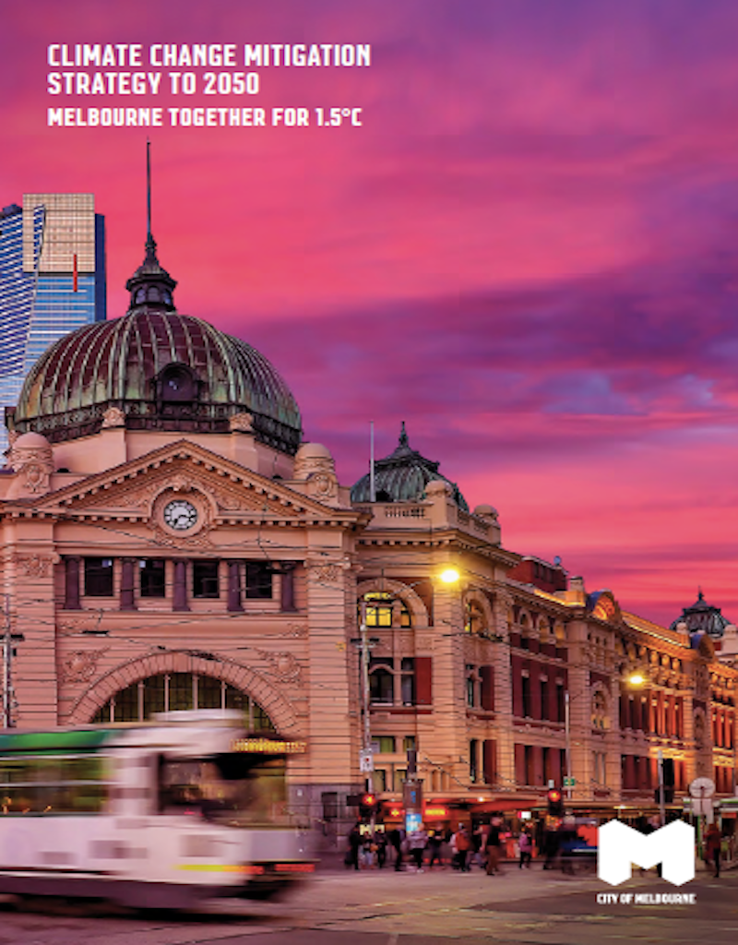
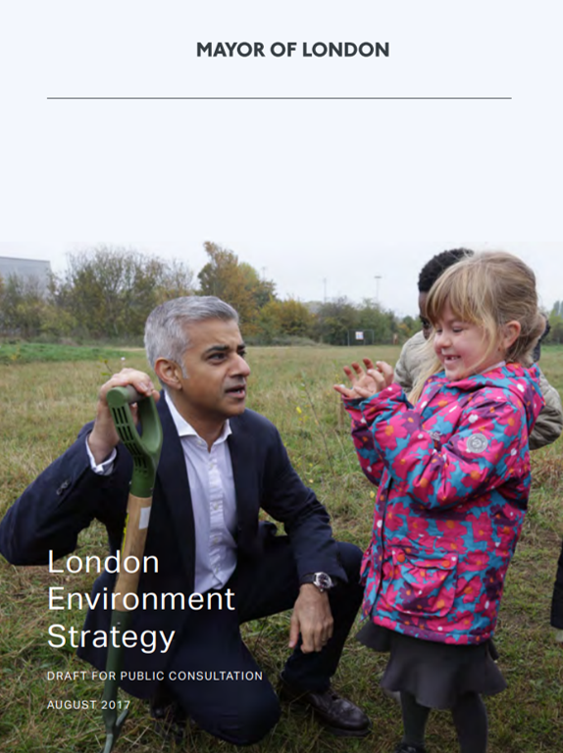
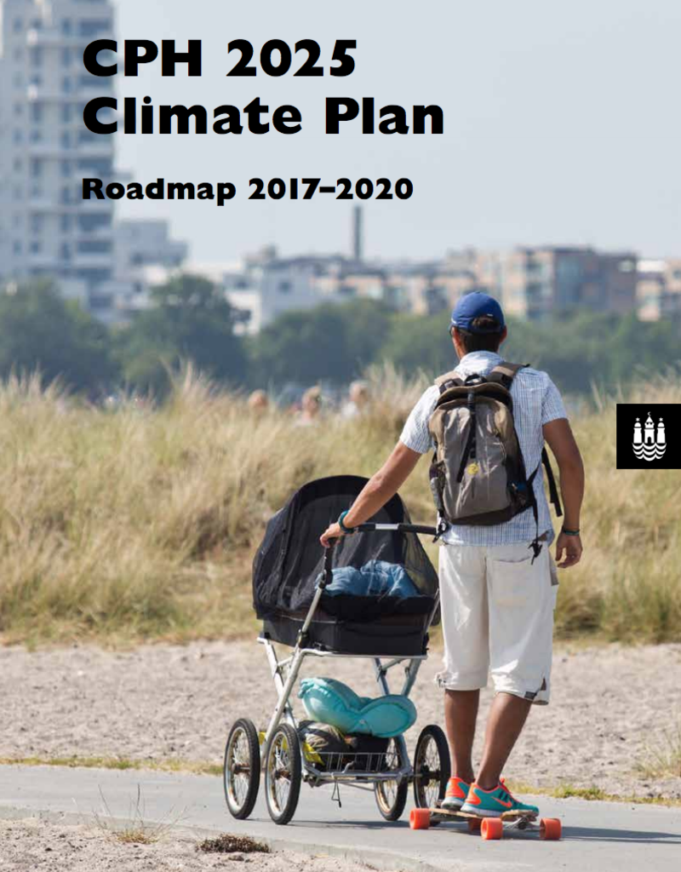
Cities have ambitious climate action plans

Slide 8
C40’s vision of climate action is rooted in equity and a green and just future for all.
Because we know that climate, social and economic justice can only be achieved together.
© filmstudio / Getty Images

Slide 9
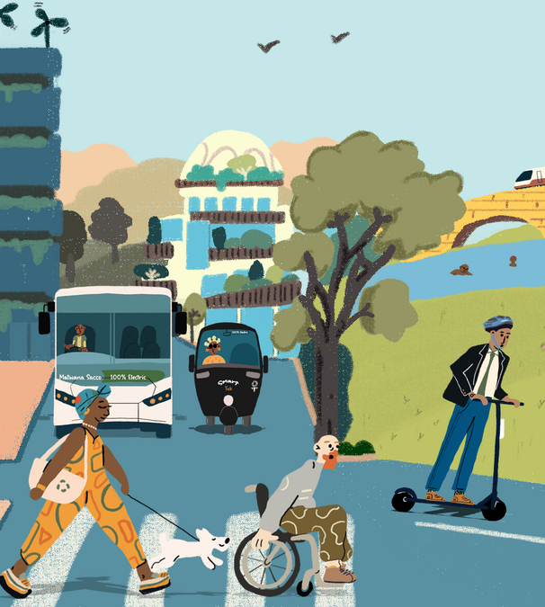
C40 supports mayors and city staff in building resilient, sustainable and equitable cities by tackling some of the highest-polluting sectors and integrating climate adaptation measures.
C40 has programmes and initiatives across the following areas:
Adaptation & water
Air quality
Energy & buildings
Food systems
Transportation
Urban planning
Waste management
© Joan Sullivan / Climate Visuals Countdown
© Njung'e Wanjiru / C40

Slide 10
The world’s cities are uniquely vulnerable to climate risks, including droughts, extreme heat, extreme cold, extreme snow, monsoons, flooding, sea-level rise, wildfires, cyclones, hurricanes, subsidence, landslides, rockfalls, air-borne disease, water-borne disease, insect infestations… C40 supports cities to reduce these risks.
© brizmaker / Getty Images

Slide 11
Why all cities need an ambitious and robust climate action plan
Global GHG emissions must be halved by 2030 and reach net zero by 2050.
Climate action planning is essential to a climate-safe future.
All cities must
Use available powers and influence to achieve net zero emissions by no later than 2050
Strengthen their ability to deal with the impacts of climate change through adaptation
Take transformational action to reduce emissions both within and outside their administrative boundaries through supply chains.
© Tess Smith-Roberts / C40

Slide 12
A robust Climate Action Plan will
Set the pathway to deliver an emissions-neutral city by 2050 at the latest, and with ambitious interim targets, i.e. every 5-years.
Demonstrate how the city will adapt and improve its resilience to current and future climate hazards.
Detail the wider social, environmental and economic benefits expected from implementing the plan, prioritising inclusive and equitable climate actions that benefit all citizens.
Outline the governance, powers and partners the city needs to engage to accelerate the delivery of its mitigation and resilience targets and goals.
© Charlotte Ager / C40

Slide 13
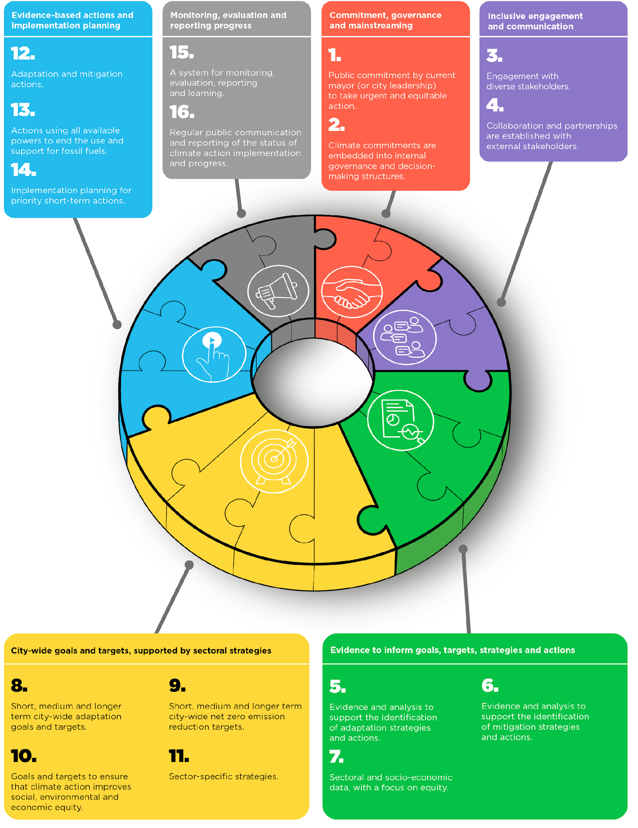
C40 Cities Climate Transition Framework
Outlines an integrated and collaborative approach to city-led inclusive climate action on adaptation and mitigation, including action to address the impact of urban consumption.
Streamlined based on years of experience from supporting cities in developing climate action plans.
Incorporates the recommendations from the Integrity Matters report from the UN Secretary High Level Expert Group (HLEG).
A stronger focus on:
Adaptation
Phasing out fossil fuels
Emissions from urban consumption
Governance and mainstreaming
Monitoring, evaluation, Reporting and learning
© Courtney Ahn / C40

Slide 14
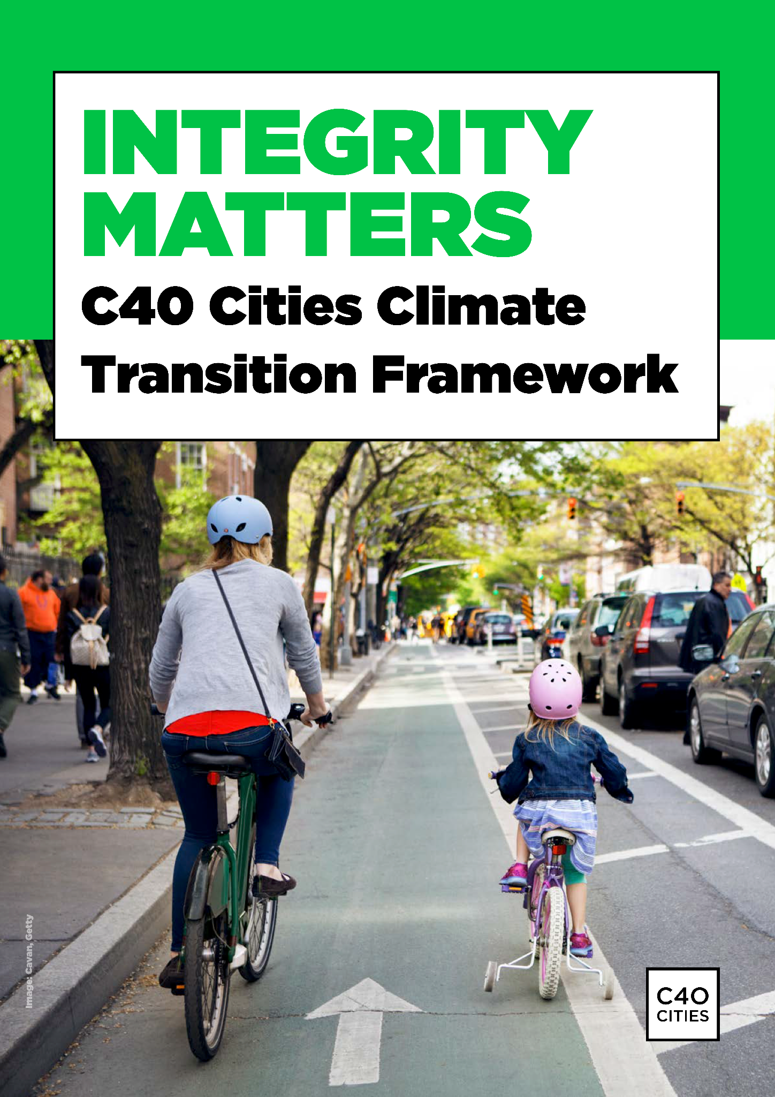
Knowledge and resources
Explore our Climate Action Planning Guide and related resources on our Knowledge Hub.
Explore the ambitious climate action plans of C40 cities with our map.
Find the C40 Cities Climate Transition Framework (draft) on the Knowledge Hub.
Thank you!
© Courtney Ahn / C40

