Slide 1
How multi-level cooperation fuels the green transition
Tue Damsø // CONCITO Webinar: Collaborative Urban Transformation // State of Green // 18. September 2024

Slide 2
Why local action?
Local governments can contribute to mitigating climate change in several ways.
Consumer: Municipalities can transition their own administration, e.g. buildings, vehicles, procurement.
Supplier: The municipalities supply a number of services to citizens through their own utilities or public tenders, e.g. waste collection and treatment, water, wastewater, district heating, public transit.
Legislator: Municipalities have a number of legislative tools to promote a green transition, e.g. spatial planning.
Facilitator: The municipalities have a large range of ‘soft’ powers. They can use their social and political influence to encourage citizens and businesses to transition, they can create incentives and partnerships to support action in the local community and use their advocacy role.
Notes:
Contextual climate action:
- Climate change is global but both emissions sources and consesequences are distributed and must be handled in a local setting.
- In addition, many of the solutions that we aim to implement have a more decentralised dispersion (i.e. renewable energy)
Synergies:
- The coupling of climate action with other targets is inherently contextual
Legitimacy:
- The subsidiarity principle states that decisions should be made as close to the citizen as possible. E.g. the EU should not take action that might be addressed at the national level to a sufficient degree. This is a democratic principle but also a practical one. It is far easier to ensure participation and legitimacy at the local level than it is at the national level.

Slide 3
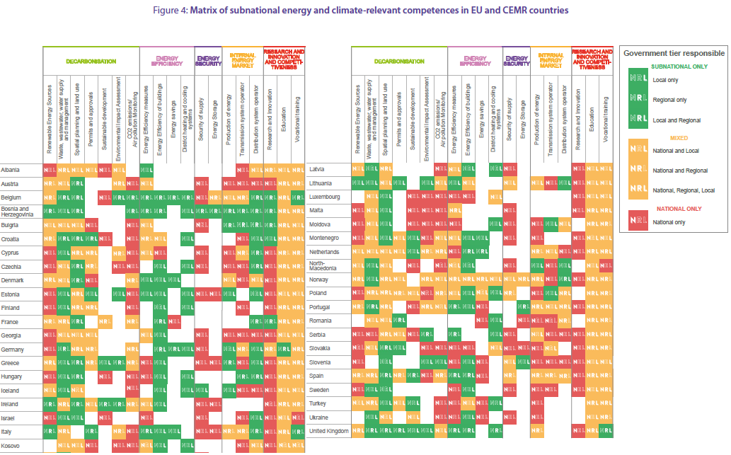
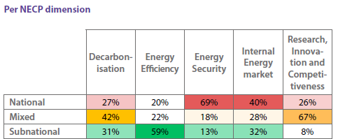
CEMR, 2023: Powering the Future: Driving Europe’s Climate and Energy Policies through Regions and Municipalities

Slide 4
Local governments in Multi-level governance
CHAMP
Challenge
Innovate
Implement
NECP
NZC

Slide 5
The Danish case: A bottom-up multi-level collaboration

Slide 6
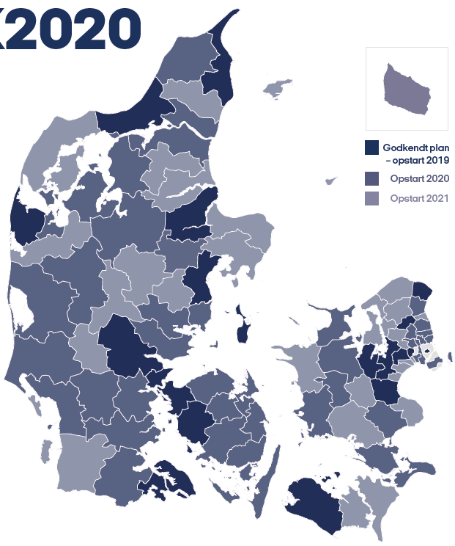
DK2020
Danish partnership between Realdania, Local Government Denmark and the five Danish regions, with CONCITO as project manager and knowledge partner alongside C40 Cities.
Aim: To aid all Danish municipalities in developing Paris compatible climate action plans following C40 standard for climate action planning (CAPF).
Municipalities working in three groups spanning five years in total (2019-2023).
Multi-tiered support structure with a global expert (C40) a national lead knowledge partner (CONCITO) and decentralized support units providing varied and complementary support and guidance.

Slide 7
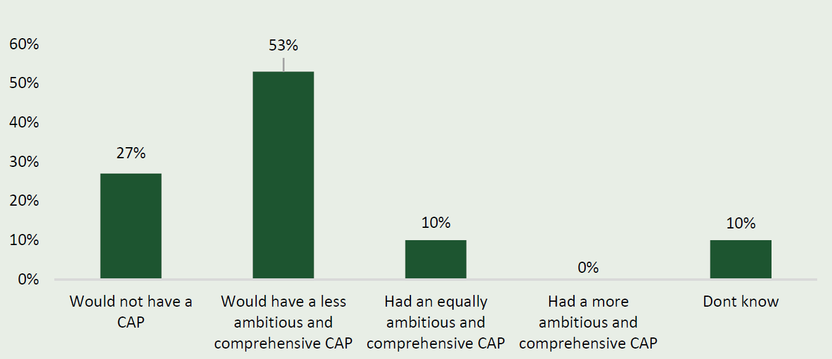
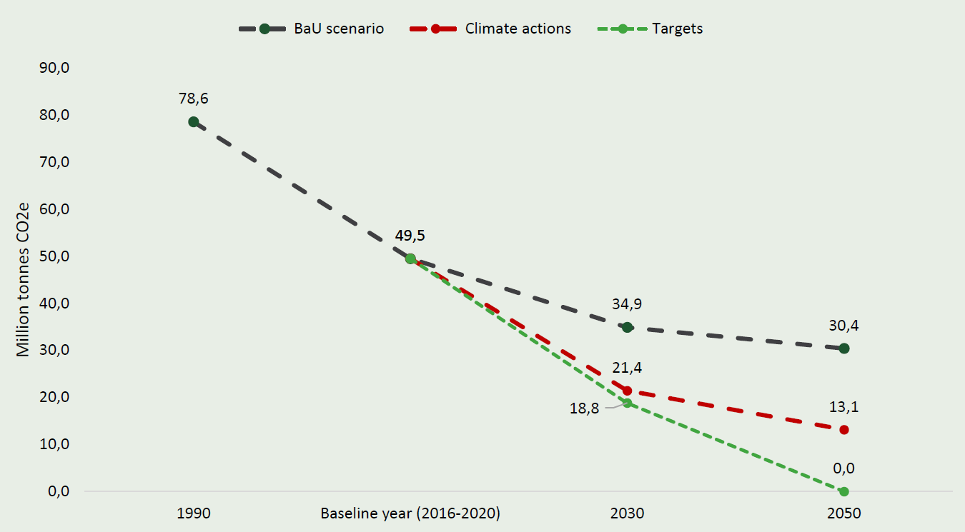
Main results
96 of 98 Danish municipalities have a certified Paris compatible CAPs. The last two are in the process of developing a CAP.
Taken together, the mitigation targets of Danish municipalities would result in a 76% reduction of overall Danish emissions in 2030 compared to 1990.
With their planned climate actions, they expect to reach a reduction of 73%
And finally, the project has had a significant impact on building capacity for climate action in Danish municipalities.
Raising awareness on climate change among decision-makers
Building knowledge, insight and competence in municipal administrations.
Mainstreaming climate action across the municipal administration
Engaging the local community and establishing partnerships
IRIS Group & Pluss Leadership, 2024. n = 49
Ea Energy Analysis, 2024.
Notes:
96 of 98 Danish municipalities have a certified Paris compatible CAPs. The last two are in the process of developing a CAP.
27% expect they would not have had a CAP without DK2020, another 53% that their CAP would have been less ambitious.
Taken together, the mitigation targets of Danish municipalities would result in a 76% reduction of overall Danish emissions in 2030 compared to 1990.
With their planned climate actions, they expect to reach a reduction of 73%
On adaptation the majority of municipalities (88%) have targets addressing water and flooding and about half have targets on drought.
They plan for analyses, policies and construction projects to adapt to rainfall and sea-level rise.
And finally, the project has had a significant impact on building capacity for climate action in Danish municipalities through:
Raising awareness on climate change among decision-makers
Building knowledge, insight and competence in municipal administrations.
Mainstreaming climate action across the municipal administration
Engaging the local community ad establishing partnerships

Slide 8
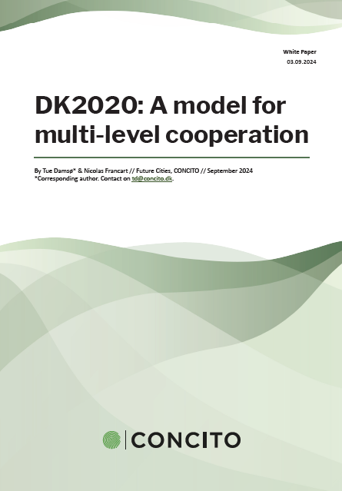
DK2020 and Multi-level governance
In Denmark: DK2020 has planning and capacity building among local governments, creating the basis for an effective MLG system.
The national government can build on that in their NDC.
Abroad: DK2020 can act as inspiration in establishing multi-level structures to support local action.
Can be adapted to fit local circumstances based on learnings and insights.
DK2020 white paper now available at https://concito.dk/en/

Slide 10
Ekstra

Slide 11
Local governments in Multi-level governance
Contextual climate action
Implementation: Local actors can contribute to enact and carry out national policies and plans, taking local characteristics into account.
Development: Local actors can aid in developing and testing climate solutions in a smaller scale, before transferring them to the entire country (when they work out). Laboratory for innovation.
Challenge: If the national level does not enact sufficient climate actions, local governments can challenge the status quo through catalytic activism. By planning and implementing climate actions they can put pressure on national actors and raise the bar. In this role local action can be viewed as an ‘insurance’ against insufficient action at the national level.
Synergies in climate action
Legitimacy in climate action

Slide 12
Increasing focus on multi-level collaboration
Coalition for High Ambition Multilevel Partnerships (CHAMP)
Endorsed by 72 countries (including Denmark) pledging to enhance cooperation with subnational governments where applicable and appropriate in planning, financing, implementation and monitoring of climate strategies (including NDCs).
UN Habitat found that 2/3 CHAMP endorsers have the opportunity to strengthen their NDC on urban content.
National Energy and Climate Plans (NECP)
Under the EU energy union and climate action framework, Member states are required to establish and periodically revise ten-year National Energy and Climate Plans (NECPs) and establish Multi-level Climate and Energy Dialogues (MCEDs) as part of that.
CEMR found that local and regional governments have mainly received top-down information with no real opportunity to contribute to the development of the NECP.
EU Mission for Net Zero Cities (NZC)
In the EU Mission on Net Zero Cities, 112 municipalities develop Climate City Contracts with regional and national governments outlining the responsibilities of each on ensuring a climate transition.

Slide 13
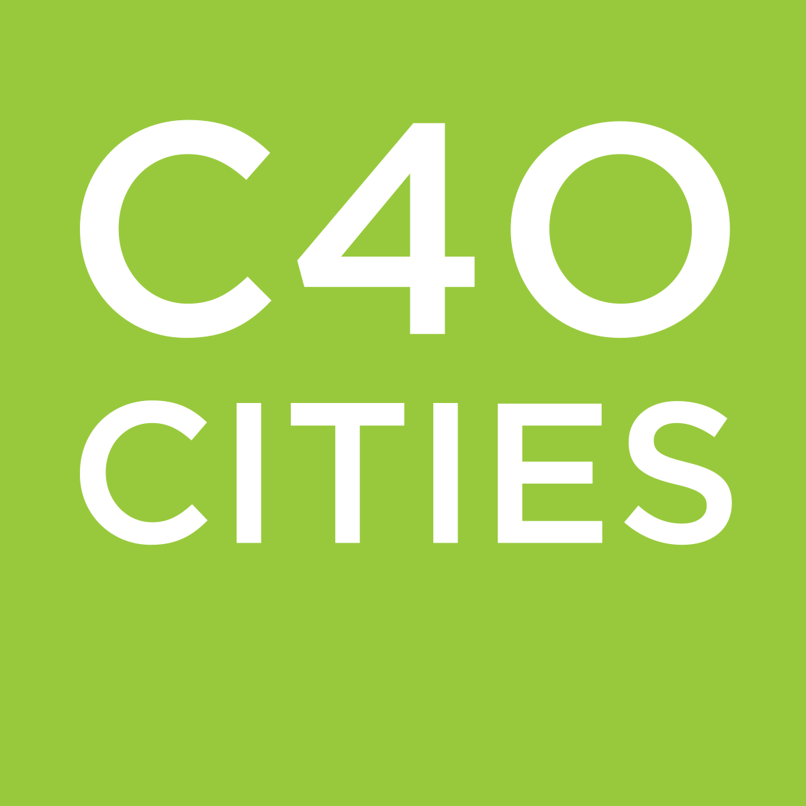
Municipal action on climate change
C40 Cities 96 member cities 600/900 mil. inhabitants 36% of global GDP 1.0000 high-impact actions
Global Covenant of Mayors
13.000 members 1.8 BN inhabitants 24 BN tons CO2e by 2030

Slide 14
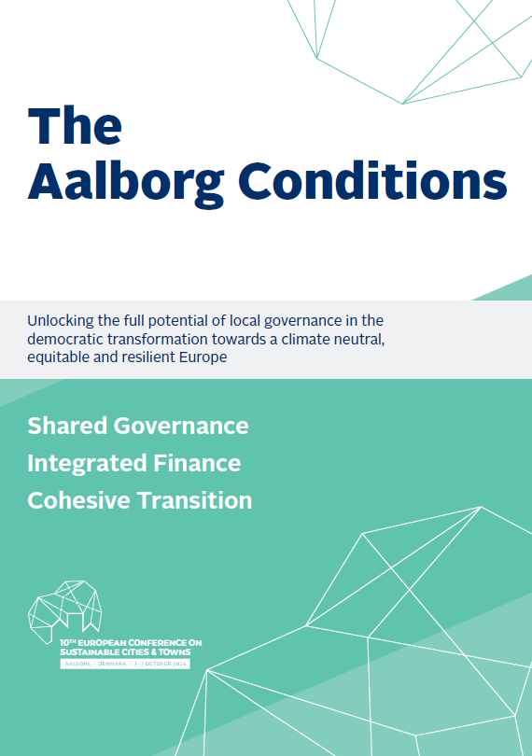
The Aalborg Conditions
Local governments walk the talk – but can’t do the job alone
Condition 1: Shared governance
Condition 2: Integrated finance
Condition 3: Cohesive transition

