Slide 1
CO2mpare
Sharing data to advance decarbonisation
Andreas Sørensen
18/09/24

Slide 2
Andreas Sørensen Digital Lead Sustainability
Ramboll Buildings

Slide 3
Geographical footprint
Ramboll presence
Ramboll head office
Ramboll offices
>18,000
>35
Experts
Countries covered by global office network

Slide 4
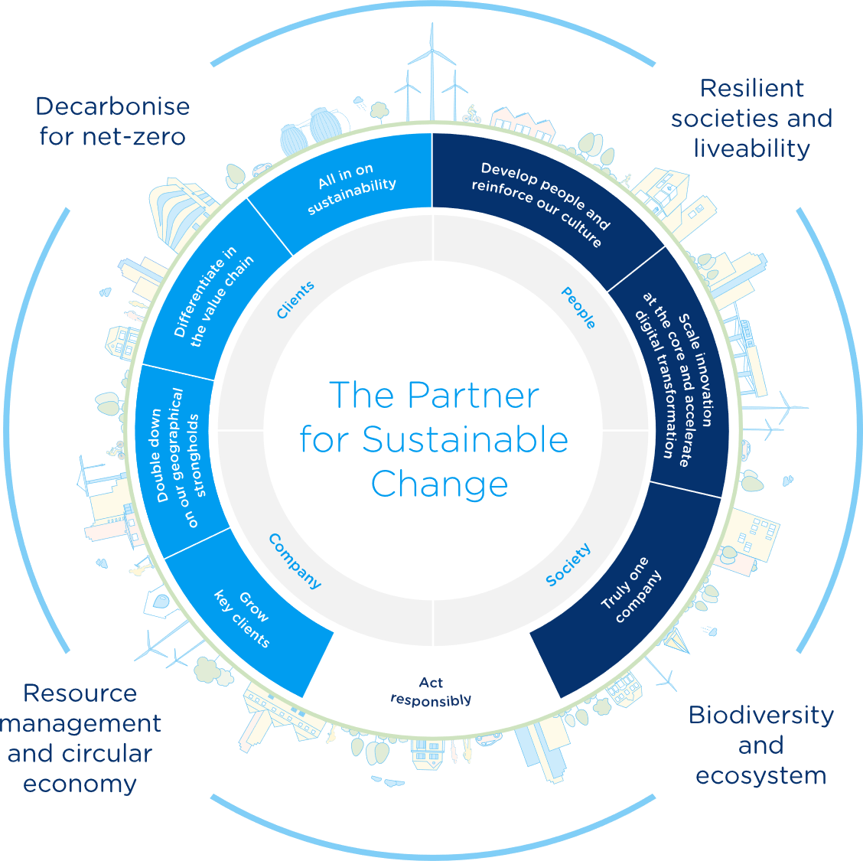
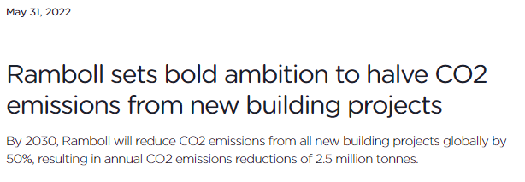
We need data!

Slide 5
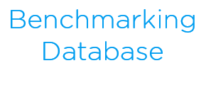
Ramboll’s Carbon Benchmarking Database
EPD
EPD
EPD

Slide 6
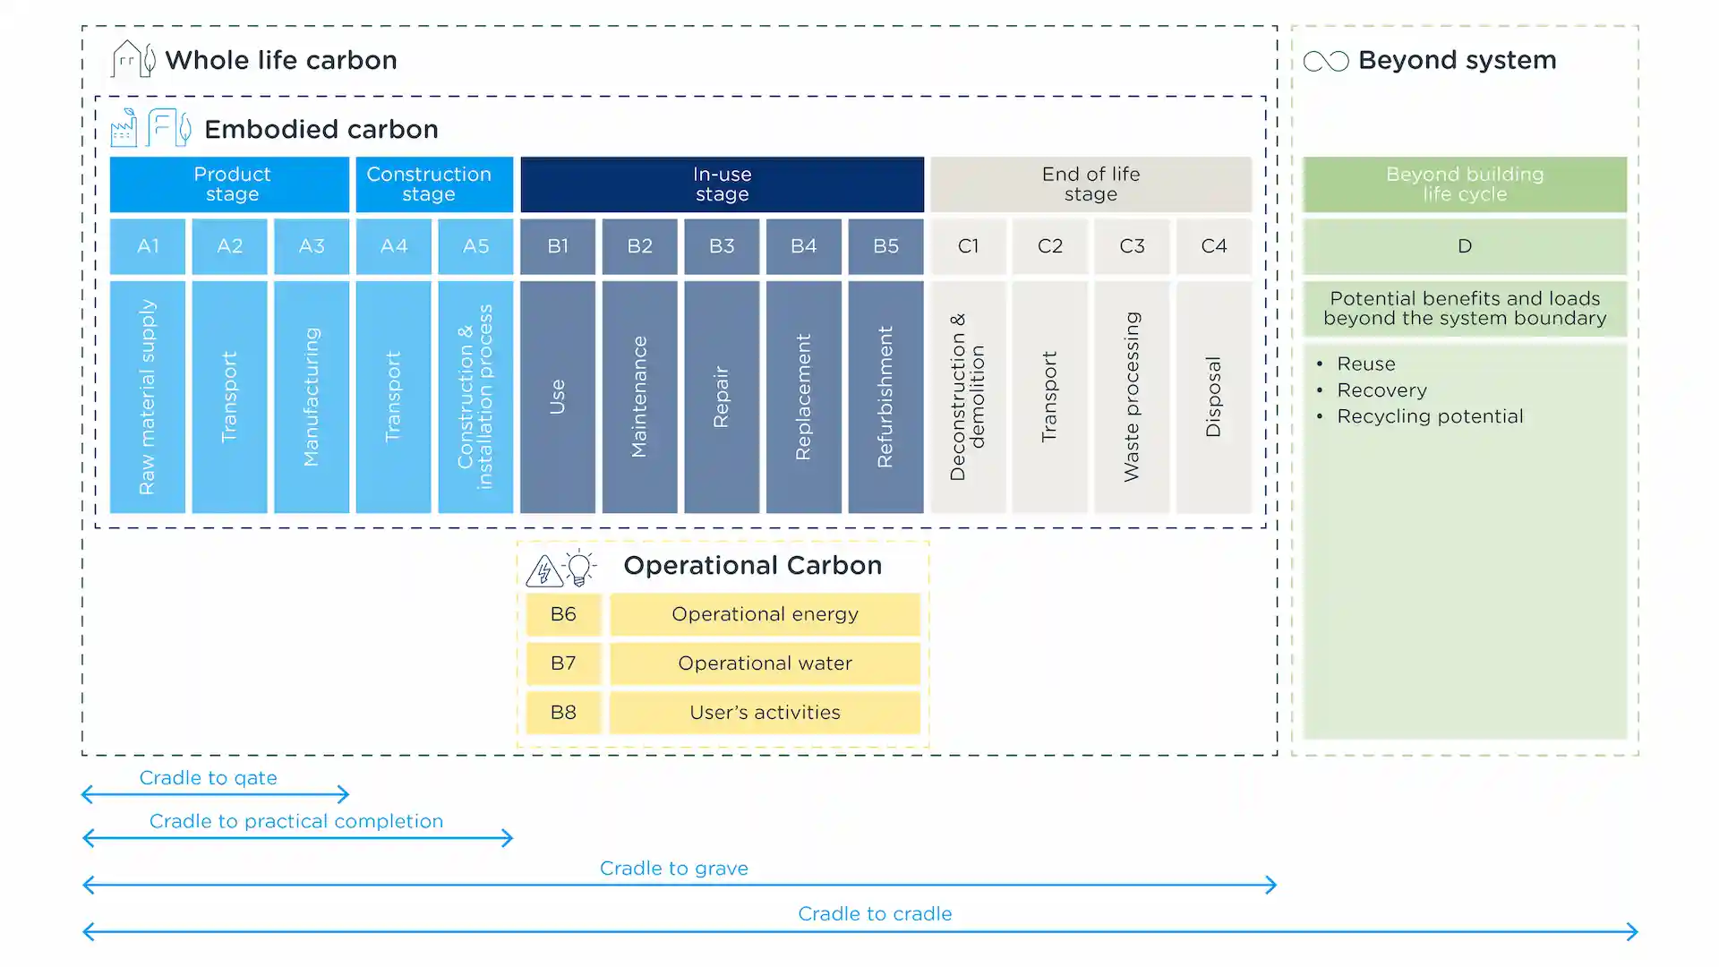

Slide 7
Which life cycle stages are included in the scope?

Slide 8
Sources of uncertainty across carbon assessment methods
Environmental data
What is the source of data and is it generic data or EPDs?
The reference study period
Is the assumed or required lifespan in the scheme 50, 60 or 75 years?
3
4
Building elements included
Some schemes only include the superstructure, some include many building elements.
2
5
The definition of a m²
Gross Floor Area, Gross Internal Area?
Life cycle stages included
Some schemes include only A1-A5, some include also B, C and D-stages.
The human factor
Stage of the design, which tool is used, is it used correctly, risk of errors, etc.
1
6

Slide 11
Ramboll’s Carbon Benchmarking Database
EPD
EPD
EPD

Slide 12
Ramboll’s Carbon Benchmarking Database
EPD
EPD
EPD
Lifecycle scope mapping
Building element scope mapping
Reference period normalisation
Floor area normalisation

Slide 13
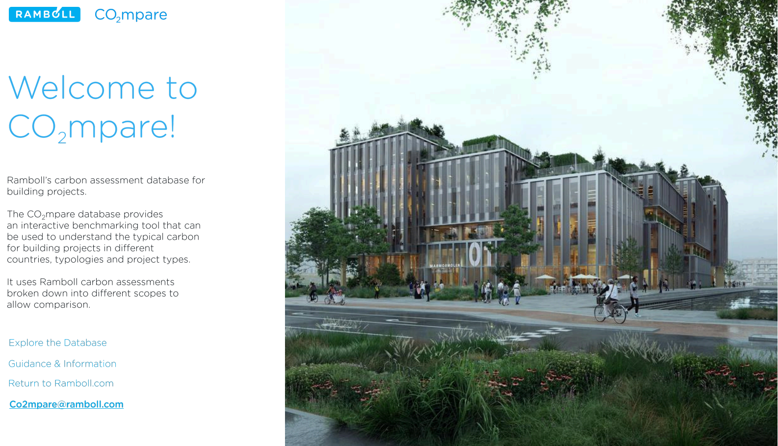
V2.0
More data
More scopes
More insight

Slide 14
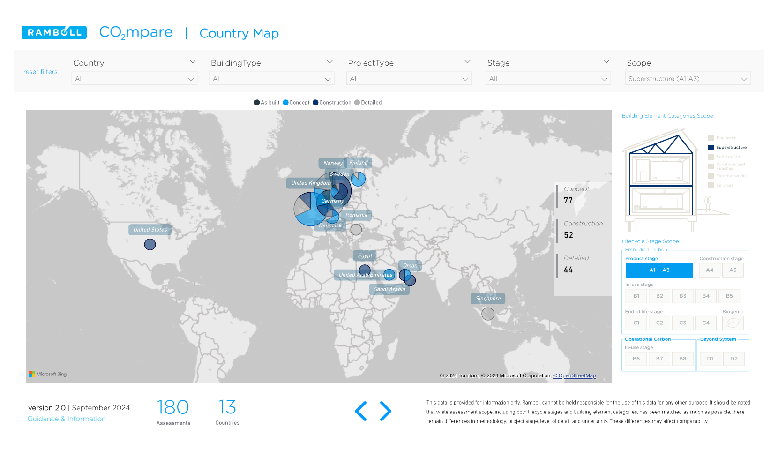
Interactive filters
Scope Explanation

Slide 15
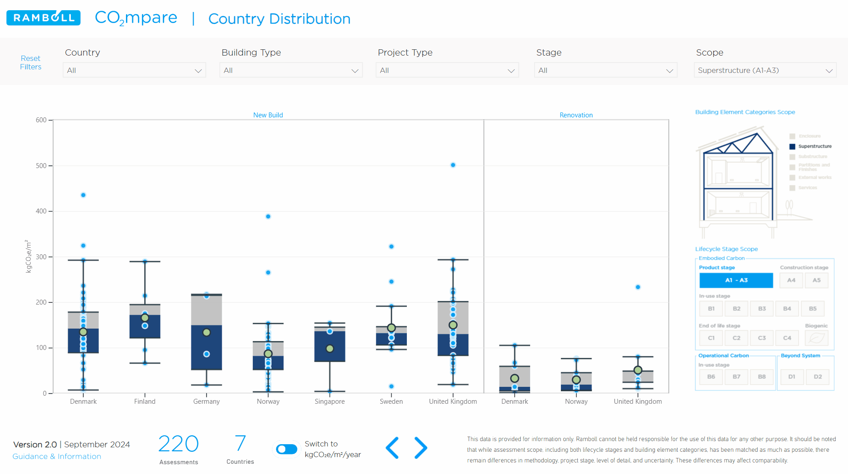

Slide 16
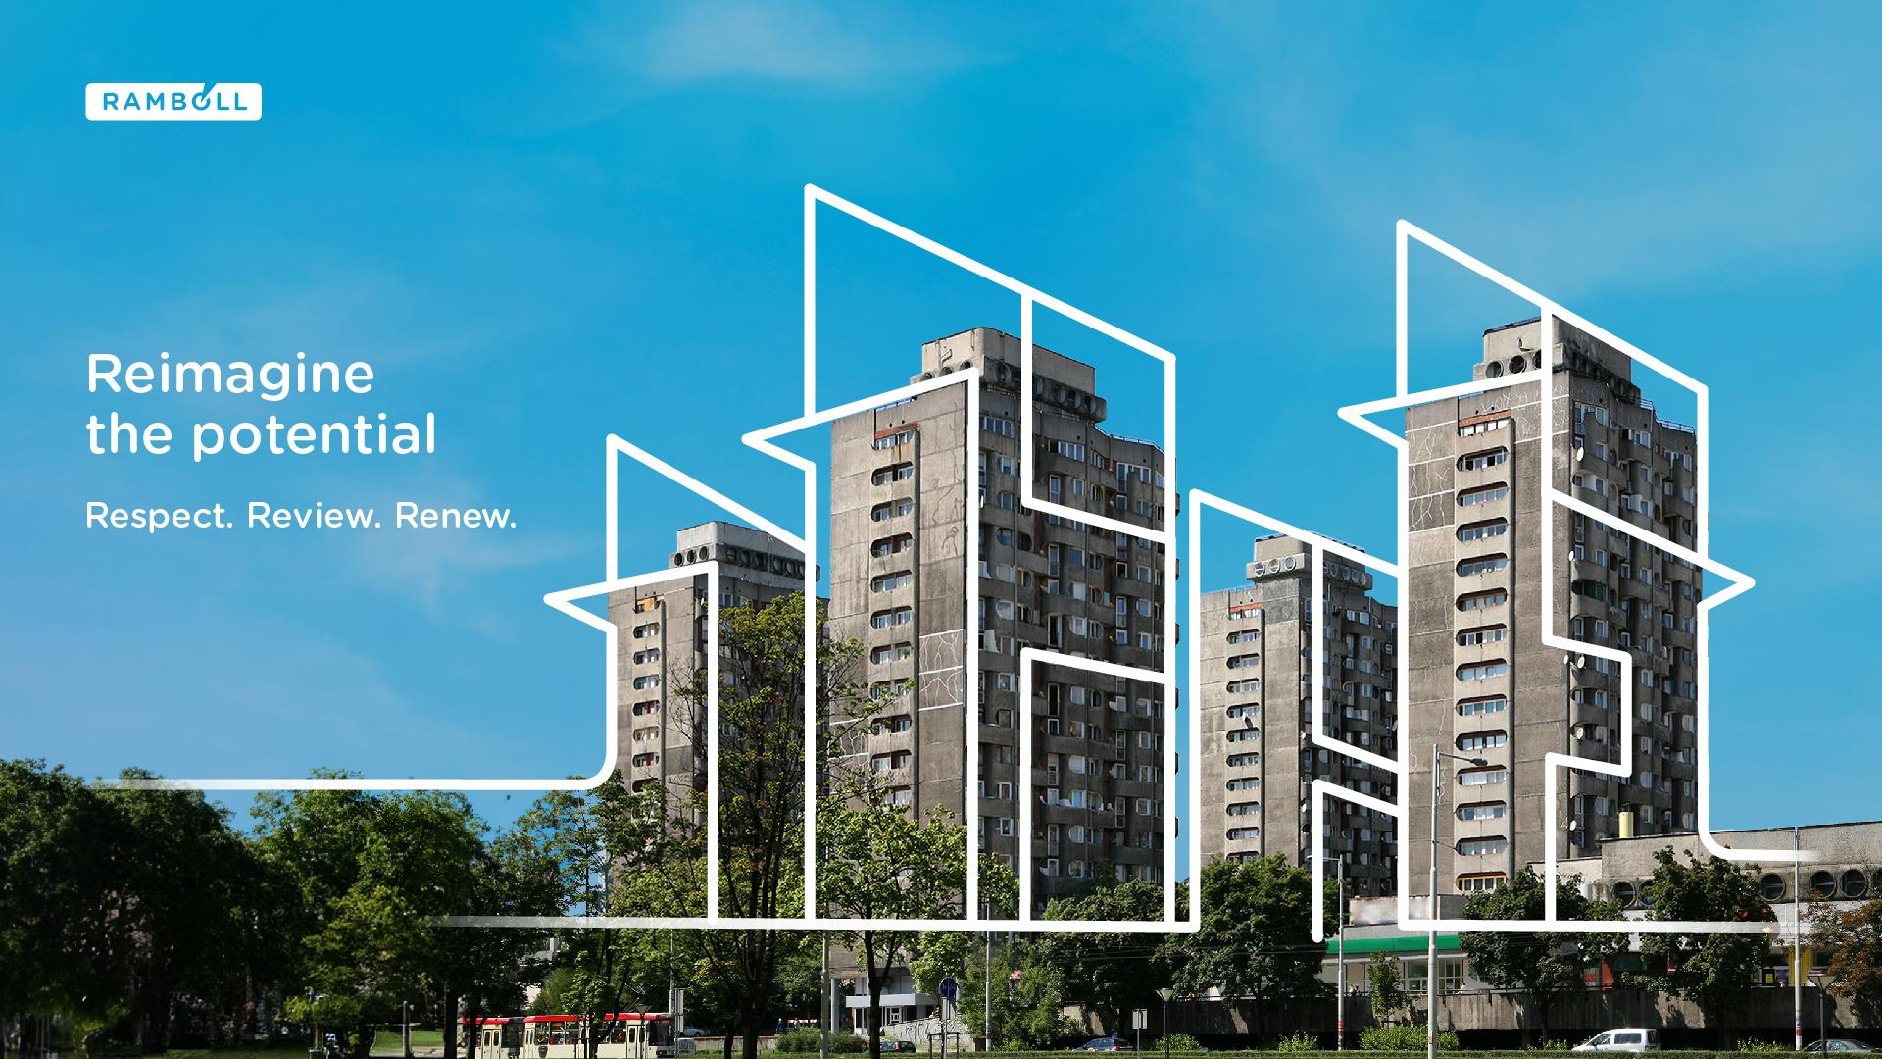

Slide 17
Concluding Thoughts
We are focusing on collecting quality data to support decarbonisation
Consistency and granularity are needed to provide actionable insight
Transparency is key for the industry and decision makers
We see CO2mpare as a step to helping move the industry forwards
Explore the data and see what you think…

Slide 18
w

