Slide 1
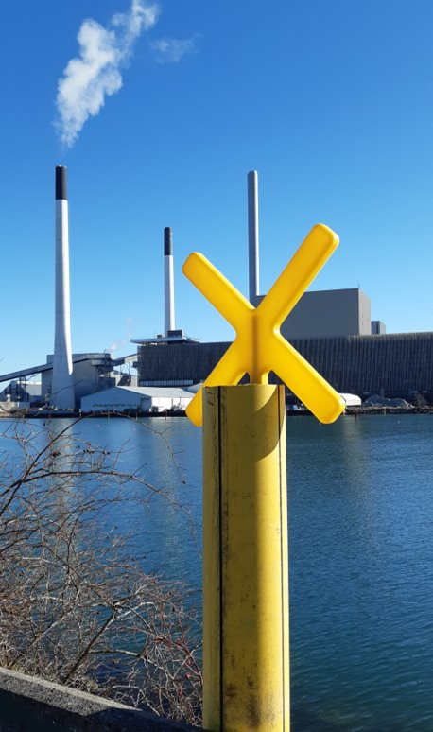
District Heating in Copenhagen Municipality
Maëlle Caussarieu
Energy Planner
Climate Secretariat

Slide 2
Intro to Greater Copenhagen District Heating Network
26 Municipalities
2 transmission companies (180 km)
3 incineration CHP
2 biomass CHP
Peak-load productions
500.000 households
32 – 34 PJ / year
15% of Denmark’s heat demand
99% of Copenhagen is connected to the DH grid (55% of Greater Copenhagen heat demand)

Slide 3
DH production in Greater Copenhagen
Notes:
Tilbage til i dag:
I dag bruger vi i hovedstadsområdet primært biomasse og affald til varme og elproduktion – biomasse står for ca. 2/3 af varmeproduktionen i hovedstadsområdet
Men hvis vi skal udfase biomasse, som der et politisk ønske om:
Røde viser kapacitet der mangler, hvis blokkene skal ud udfases
Hvilke kontrakter udløber=
Avedøre 2 (2027) + 1 (2033)
Amager blok 1 (2029)
OBS! Figuren viser hele hovedstadsområdet – ikke kun KK.

Slide 4
Intro to Greater Copenhagen District Heating Network
26 Municipalities
2 transmission companies (180 km)
3 incineration CHP
2 biomass CHP
Peak-load productions
Copenhagen Municipality owns partly CTR, VF, ARC and owns fully HOFOR
The municipality is also the heating authority (approving heat projects of HOFOR and Copenhagueners)

Slide 5
What is Copenhagen Municipality’s role?
Municipality as a company
Municipality as an authority
Influence
Municipality as a company-owner
Municipality as a facilitator
CO2 reduction potential
Notes:
Charlotte
Hvilke metodiske områder har vi?
Vi går fra en systemændring til at påvirke det enkelte individ.
Kommunen som virksomhed: stille krav i indkøb og egne handlinger
Kommunen som myndighed: stille krav i div. myndighedsopgaver som f.eks.
Kommunen som selskabsejer: Stille krav til selskabernes ageren, f.eks.
Kommunen som facilitator: Hjælpe københavnerne med grønne nabofællesskaber, ændring i forbrugsmønstre mv.
Vores muligheder for indflydelse falder i den kommende klimaplan, når vi bevæger os over mod adfærd.
Vi undersøger mulighederne for hhv. at arbejde med indikatorer i højere grad, når kausaliteten bliver udvisket, for at kunne følge graden af påvirkning bedre. Det undersøges også hvordan vi kan arbejde med flere delmål der placerer sig forskelligt i forhold til sikkerheden i at op nå dem.

Slide 6
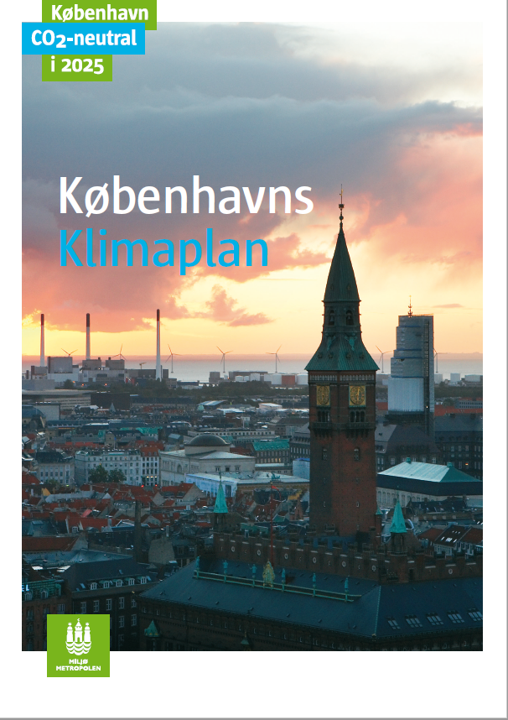
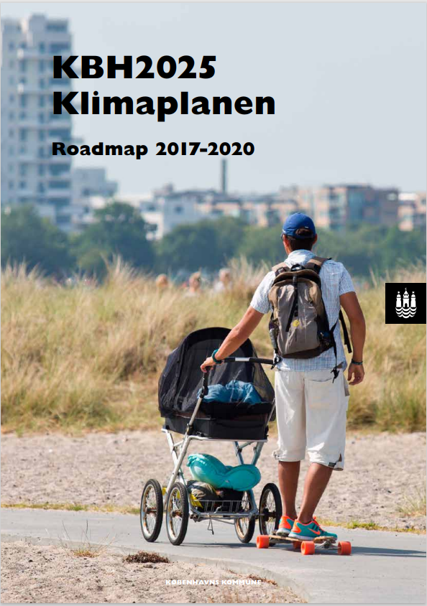
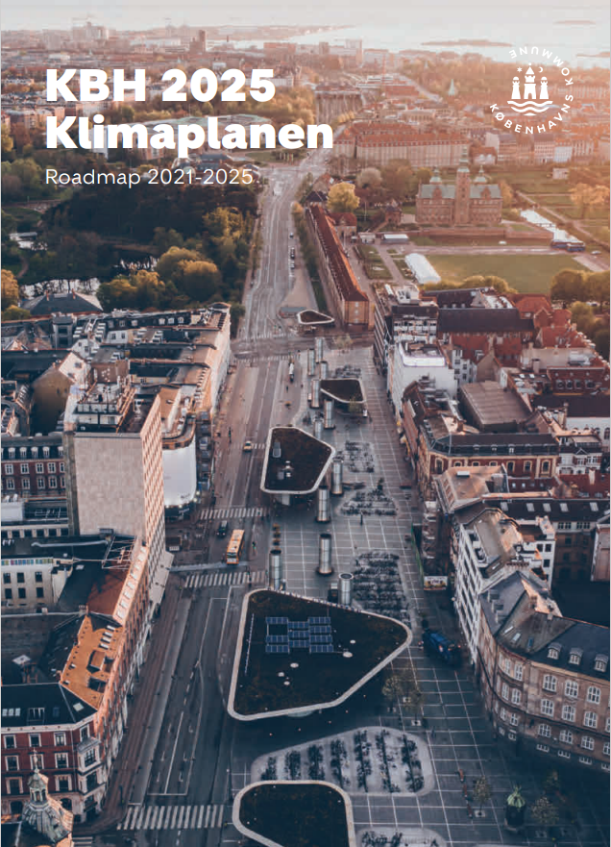
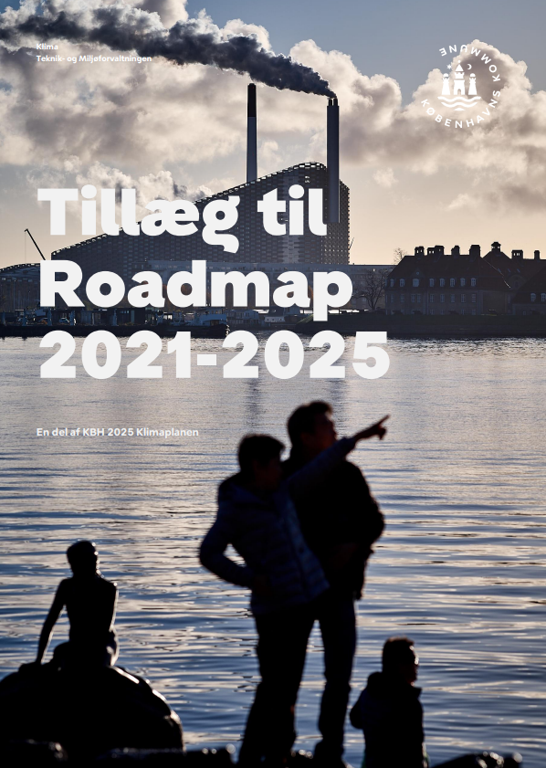
What is Copenhagen Municipality’s role?

Slide 7
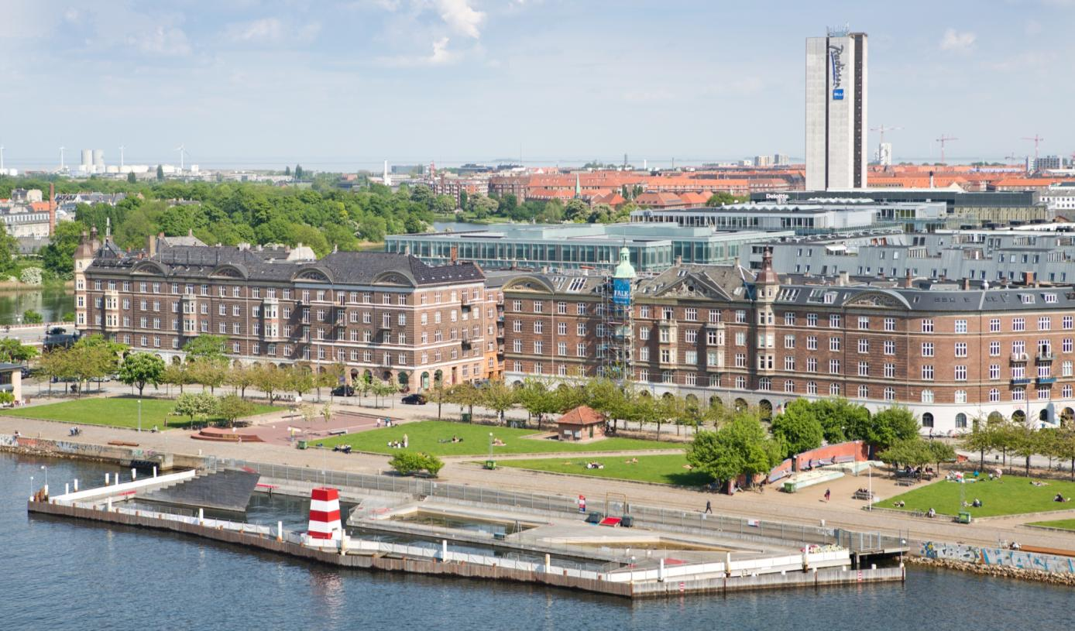
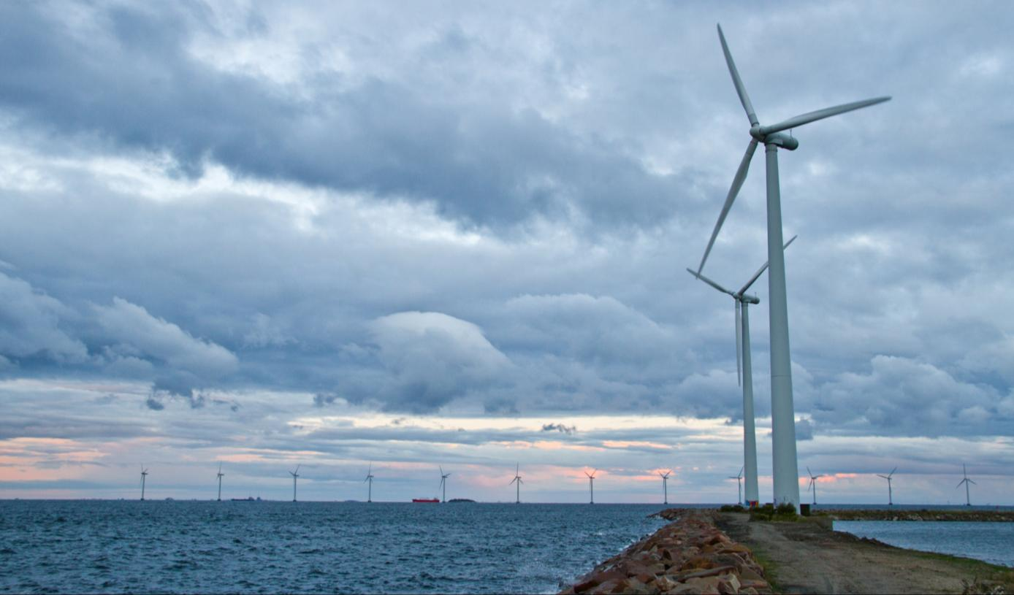
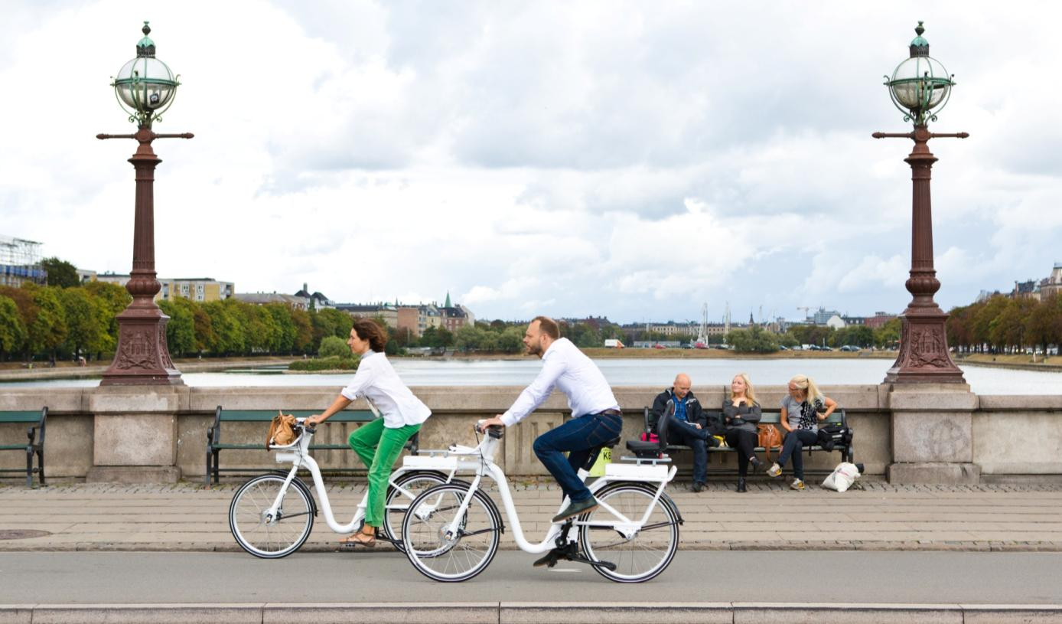
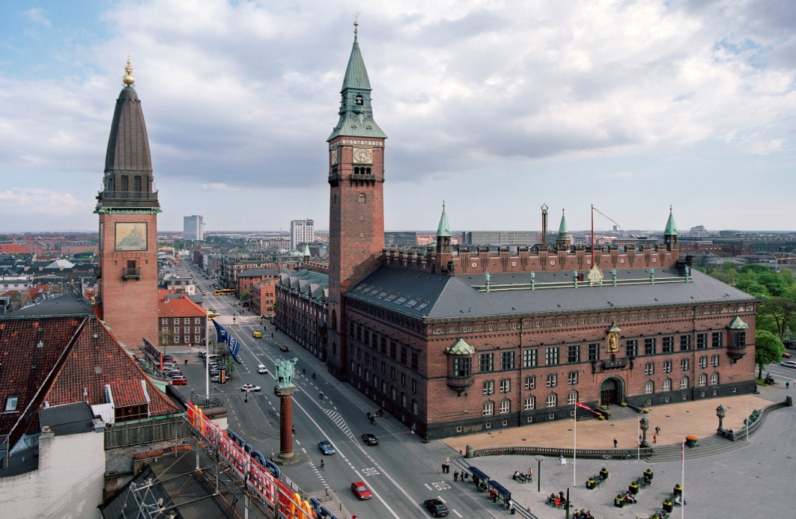
Climate plan and its four tracks
ENERGY CONSUMPTION
ENERGY PRODUCTION
1%
86%
12%
1%
MOBILITY
MUNICIPALITY AS A COMPANY
Notes:
Fire spor:
Energiforbrug – lille andel af CO₂ besparelser
Energiproduktion – el + fjernvarme + CCS
Mobilitet
KK som virksomhed – egne køretøjer, egne bygninger, gadebelysning, etc

Slide 8
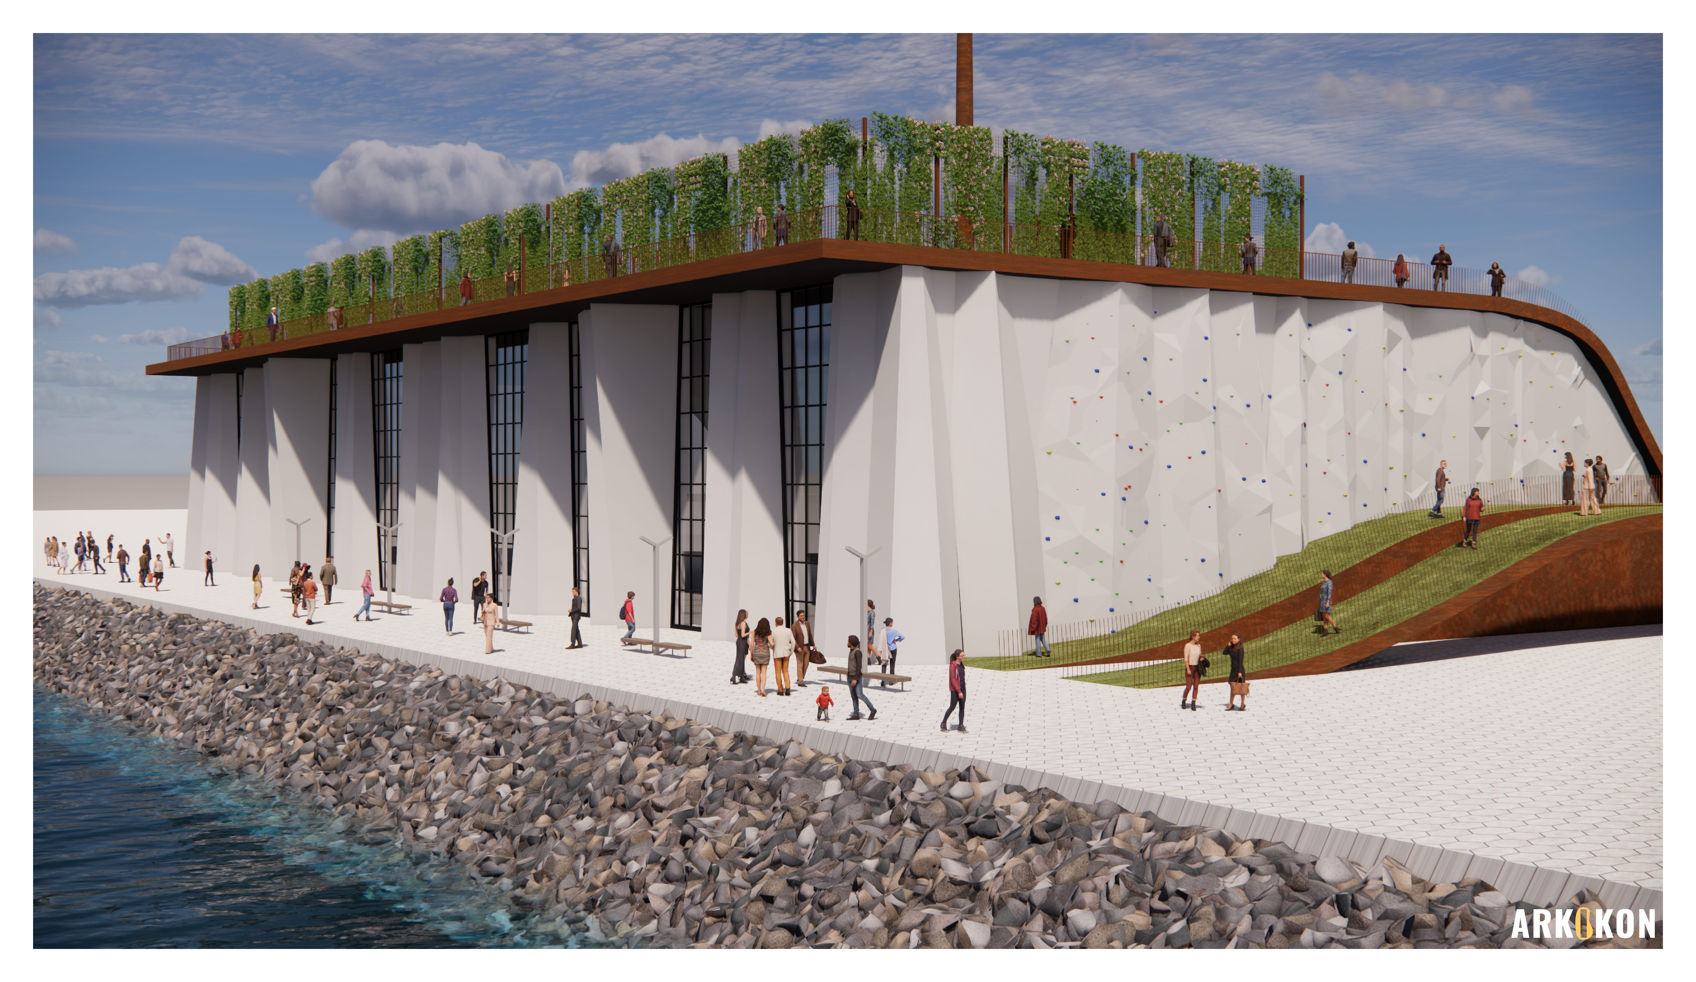
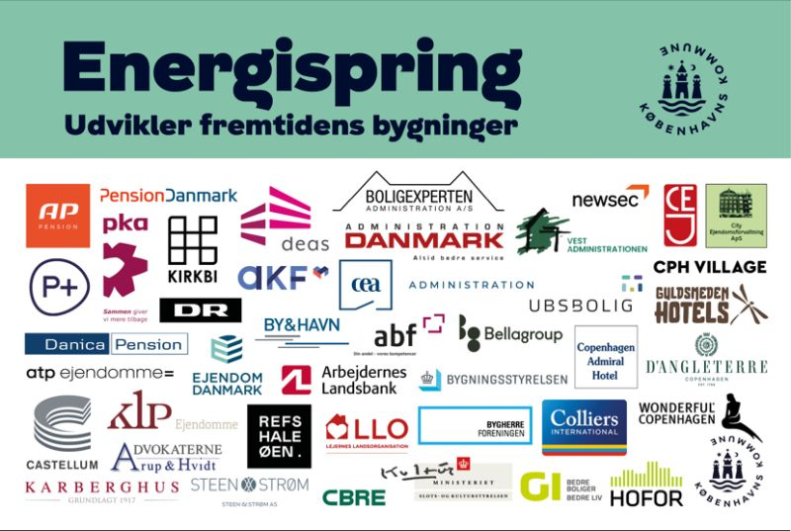
What is Copenhagen Municipality’s role?
In the Climate Secretariat, our role is to
Strategic development of the climate/energy plans
Monitoring the climate/energy plans
Coordination between the politicians and the companies
CO2 accountancy
More specifically regarding DH:
Finding areas for large-scale heat pumps
Energy consumption initiatives
Low-temperature strategy – with HOFOR
Sorting of plastics from waste
…

Slide 9
What is our biggest challenge? (And how do we work with it)
Many different agendas, from the politicians as well as from the companies
Many things we cannot directly act upon
Many unknown about the coming future

Slide 10
What is our biggest challenge? (And how do we work with it)
Elnet
El
El
El
El
El
Ilt
E-fuels
Vedvarende energikilder
Elektrolyseanlæg
Varmepumper
Brint
CO₂ fra biogas
”X”
Røggas med CO₂
CO₂
CHP plants
Fx AMV4
Carbon Capture anlæg
Syntesefabrik
CO₂
Bæredygtig biomasse
Udskibning til CO₂ lager
DH
Surplus heat
Overskudsvarme
Overskudsvarme
Notes:
Many different agendas, from the politicians as well as from the companies
Many unknown about the coming future
Many things we cannot directly act upon

Slide 11
What is our biggest challenge? (And how do we work with it)
Elnet
El
El
El
El
El
Ilt
E-fuels
Vedvarende energikilder
Elektrolyseanlæg
Varmepumper
Brint
CO₂ fra biogas
”X”
Røggas med CO₂
CO₂
CHP plants
Fx AMV4
Carbon Capture anlæg
Syntesefabrik
CO₂
Bæredygtig biomasse
Udskibning til CO₂ lager
DH
Surplus heat
Overskudsvarme
Overskudsvarme
Notes:
Many different agendas, from the politicians as well as from the companies
Many unknown about the coming future
Many things we cannot directly act upon

Slide 12
Developing Copenhagen’s Climate Plan 2035
Transition strategy
2026-2035
Roadmap 2026-2029
Foods
Accountancy, methods and effects
Constructions
Mobility
Energy
Things and stuff
Transport and experiences

Slide 13
Developing Copenhagen’s Climate Plan 2035
KK + energy actors in KK
The role of buildings
The role of biomasse
The role of waste incineration
The role of CCU/S
Electricity supply and sector couplings
Decentral heat productions
Wind and solar
Peak productions
Energy strategy
2026-2035
Key principles
KK
Energy plans
2026-2030
2030-2035
Initiatives

Slide 14
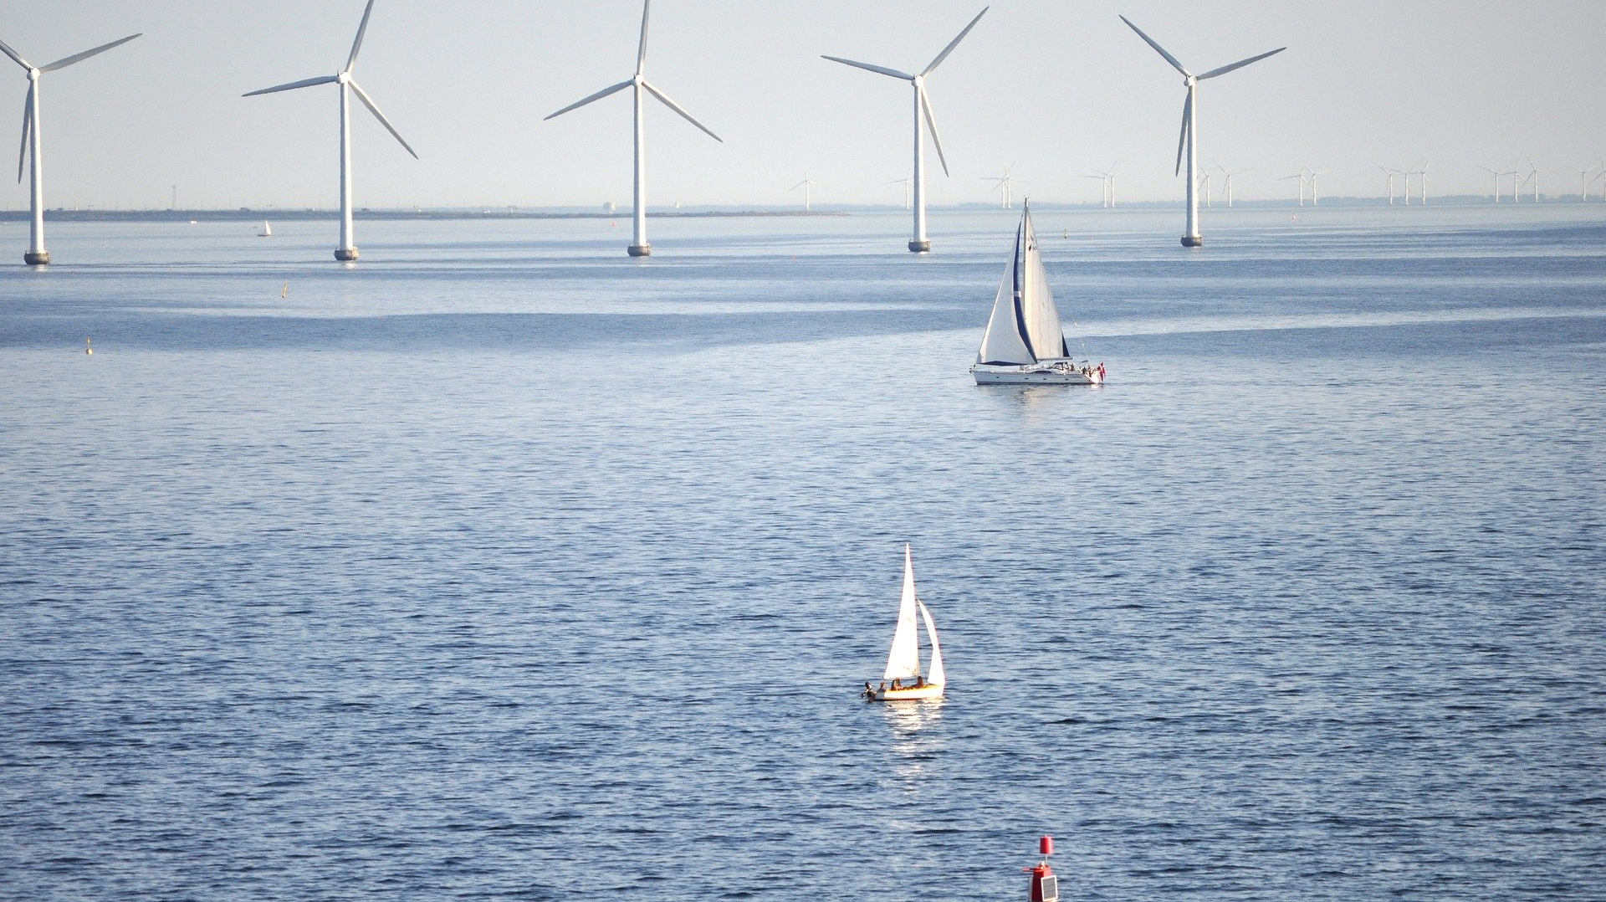
Thank you
Contact
Maëlle Caussarieu Energy Planner
City of Copenhagen
+45 2033 6198
Maelle.nolwenn.caussarieu@kk.dk

