Slide 1
From black to green – a Danish sustainable energy growth story
PUBLICATIONS FOR A GREEN TRANSITION
A case study of how an energy utility can transition from fossil fuels to renewable energy, and the enabling regulatory framework that made it possible
Connect. Inspire. Share. Think Denmark

Slide 2
The Danish renewable energy journey
TIMELINE
The Danish renewable energy journey
Key milestones in Denmark and Ørsted's transition to green energy

Slide 3
TIMELINE
1970s and 1980s
The oil crises call for new energy policies and technologies
Notes:
In 1972, oil accounted for 92 per cent of gross energy consumption in Denmark. Thus, when the OPEC oil crisis quadrupled the price of oil in 1973, Denmark’s economy and energy supplies were severely affected. While some shortterm measures such as the introduction of car-free Sundays in Denmark during the 1973/74 winter were launched, the event was the catalyst for long-term energy planning.
This culminated in the establishment of the DEA and the government’s “Danish Energy Policy 1976”. Short-term aims
ranged from reducing the country’s dependence on oil, increasing diversity of supply, reducing energy consumption
to increasing energy-related research and development. The long-term aims of the agreement were to slow the depletion
of natural resources and develop stable, long-term solutions to energy demand by utilising renewable energy sources.
However, the initial measure enacted as part of the policy was the rapid conversion of power stations from oil to coal.
Locally extracted natural gas was initially seen as a solution to the country’s energy woes and the Danish state-owned
natural gas company, Dansk Naturgas, was merged with the Danish state-owned oil company in the early 1970s to create Danish Oil
and Natural Gas A/S (DONG A/S)
Denmark said “nej tak” to nuclear in a parliamentary decision on energy planning without nuclear in 1985, which was interesting as it was actually against the minority government at the time, but was also a large public opposition. This was 1 year before the Chernobyl disaster. So, the quest for local sources of environmentally friendly energy continued, and was supported by 2 energy agreements – one agreeing on 100 MW of wind from 1986 to 1990, and one for 450 MW of decentralized CHPs based on biomass, gas, waste and biogas.
Another energy agreement was made 9 months later, where it was agreed that the energy companies would consutrct 100 MW of wind energy between 1986 and 1990.

Slide 4
TIMELINE
1990 to 1995
Sowing the seeds of sustainable growth
Notes:
Another energy agreement extended the target to another 100 MW wind energy before 1994
Energy 2000, following the energy agreement, was an energy action plan in 1990 which was a gamechanger. Climate and energy policies were integrated and it was the first governmental plan in the world to reduce CO2 emissions. This included targets of 20% reduction CO2 by 2005, and proposed taxes on CO2, SO2 and NOx which were subsequently realised in 1992, (first country to do so), 1995 and 2008 respectively.
Vindeby the first offshore wind farm was installed by Elkraft.
Feed in tariff put in place for onshore wind
In 1995, a mapping of regulatory aspects for Danish waters, points to five major areas as suitable locations for future offshore wind farms, considering interests such as military, environemtnal, navigation and so on.

Slide 5
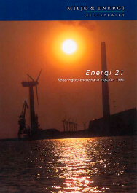
TIMELINE
1996 to 2000
Denmark at the forefront of change and the first
EU provisions for a liberal internal market
Notes:
The latter half of the decade was characterised by the gradual liberalisation and opening up of the European electricity market across national borders. This was motivated by two parallel movements – liberalisation from EU internal market, that electricity should flow freely as a commodity across borders, and the development of the electricity market Nord Pool in Norway and Sweden.
The liberalisation meant that it was necessary to pay out the electricity companies a support package of 8 billion DKK to secure their economic survival in the transition, and that they could transition to the Nord Pool power exchange to ensure the lowest possible prices for consumers.
The ministery of environment and energy mandated electricity companies to expand offshore wind by 200 MW by 1999 and 900 MW by 2006. This was followed by the minister Svend Auken making a political agreement with the energy companies to establish the two first ever large scale offshore wind farms (200MW each) at Horns Rev (by Elsam in the west) and Nysted (Energi E2, DONG and Sydkraft in East).

Slide 6
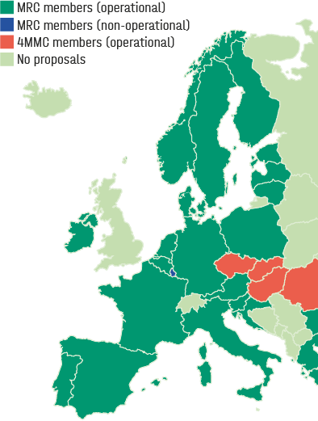
The integration of day-ahead markets started with the liberalisation in 1999 and by 2021, 25 countries have fully integrated day-ahead markets, and an electricity demand of around 3,000 TWh/year (ENTSO-E). More information can be found at (ENTSO-E, 2021)
TIMELINE
2001 to 2006
A new era for the supply of electricity
Notes:
Transition to market happened, and market coupling. A map of market coupling in the day-ahead market as of 2021 is presented, however this has been a gradual progression, which started back in 2000.
Offshore wind on the other hand saw the build out of the first two major demonstration projects, and the first tenders in the world for offshore wind. These first two tenders gave signficant learnings especially on aspects relating to environmental impact assessment, penalties, timelines and so on.
On the company side, most notably a merger of 6 power companies in 2006 meant the creation of Dong Energy A/S – an energy behemoth in Denmark, including oil&gas, power and heat production of aroudn 5.7 GW mostly coal, gas wholesale business, retail, and a small RE business which included Vindeby, Horns Rev 1 and Rødsand 1. The reason for the merger was to take control of the energy production in Denmark, and it was very close to falling into Vattenfalls hands, to the point where Vattenfall was on their way to a press conference to announce it, before they were told that no, it would actually still be Danish.

Slide 7
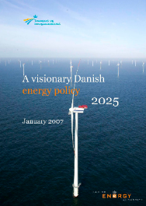
TIMELINE
2007 to 2010
DONG Energy pioneers the green transition
in response to new, long-term political targets
Notes:
Moving to 2007, leaders across EU established targets in energy and climate, what is commonly known as the 20-20-20 target in 2007, 20% GHG, 20% RE, and 20% energy efficiency by 2020.
This was an average target across EU and distributed across Europe based on their starting point, meaning Denmark had a higher target.
A crucial point was that the targets were enacted in legislation in 2009, making them legally binding.
DEA set a target of 20% RE by 2011 and 30% by 2026.
This EU target, and subsueqnet Danish target, the momentum from COP in Copenhagen, all seemed to have inspired DONG Energy to annouce a radical change in strategy in 2009. Actually a few months after the Energy Agreement was published by DEA, DONG Energy announced its 85/15 strategy, where it would change from being 85% fossil to 85% renewable by 2040.
Two other factors played a big part here – the merger meant the demonstration projects in offshore wind were in DONG Energy’s hands, and another side effect of the merger was that DONG Energy inherited a development project Greifswald in Germany, a 1600MW coal-fired project, which was met with large public resistance. DONG Energy eventually abandoned the project after spending 1 billion DKK on it.
DONG followed up on their ambition by investing largely into the new technology, 500x3.6 MW wind turbines, as it was necessary to do it at scale to get the new industry going.
They were also able to attract insitutionaly investors, as offshore wind projects are highly capital intensive, Pension fund would invest i Nysted, giving a huge capital injection. This became known as the farm-down model, where 50% of the wind farm would be divested to institutional investors, but that DONG Eneryg would take 100% of the construction risk. This mdoel is widely applied in the industry today.
The Anholt tender resulted in a higher price than Horns Rev II and Rødsand II. This gave way to several learnings such as market and technical dialogues at early stages of the tender, to ensure that terms and conditions relating to penalties and timelines do not restrict the number of bidders in the project.

Slide 8
TIMELINE
2011 to 2016
Denmark waves goodbye to coal
and DONG Energy expands overseas

Slide 9
TIMELINE
2017 to 2021
Heightened ambitions for
Denmark’s green transition

Slide 10
Policy-side learnings
Planning – setting ambitious and reliable targets | Long-term, stable, inclusive and transparent energy planning procedures, supported by legislation, concrete reforms, and dialogue with the industry and with the public, are an essential part of the green transition
Demonstration projects | Demonstration projects provide invaluable regulatory, technical and engineering learning and boost investors' confidence, proving the scalability of the technology.
Economic incentives | Subsidies, taxes and CO₂ prices have proved instrumental, when designed in a transparent manner to reduce regulatory risk
Competition | An electricity sector built on the fundamental concept of competition creates incentives to innovate and lowers prices
Permitting and de-risking | Appropriate allocation of risk and the streamlining of permitting procedures reduce regulatory risk and potential delays

Slide 11
POLICY-SIDE LEARNINGS
Planning – setting ambitious and reliable targets
In order to achieve a clear, stable and transparent policy framework,
energy planning should meet the following conditions:
1. Be long-term. By being designed with a long-term mindset, such plans provide a stable framework and the long-term horizon that industry requires to join the transition.
2. Reflect transparency and stability. If political decisions that significantly affect the business case for large investments are reversed, it will severely damage the government’s credibility with developers and investors, leading to higher prices and slower market uptake of RE.
3. Include dialogue with the future players at the early stages: a transparent dialogue between government and industry can give the necessary inputs for designing the rules from parties involved. Denmark has used industry dialogue as a methodology for collecting input e.g., for designing auctions or for collecting technology data to use in long-term analyses (technology catalogue).
4. Be supported by the legislation through concrete reforms. The first step requires the development of a reliable plan with calculations of when and how to achieve the targets in accordance with socio-economic priorities. This will then be implemented by government institutions. An example is the EU 20/20/20 targets, set in 2007 and followed by targets that were enacted in legislation in 2009.
More info here

Slide 12
POLICY-SIDE LEARNINGS
Demonstration projects
The first projects in any technology are more expensive than subsequent projects when the technology is more mature.
Demonstration projects were a key policy tool to kickstart the industry and gave the following key learnings:
Myriad of technical and engineering learnings to develop the supply chain and reduce costs
Environmental impact assessments – learnings from the offshore projects have helped shape the regulations around environmental impact assessments
Investor confidence, as the projects showed that the technology was possible at scale
Has underpinned the Danish wind industry as a first mover on offshore wind

Slide 13
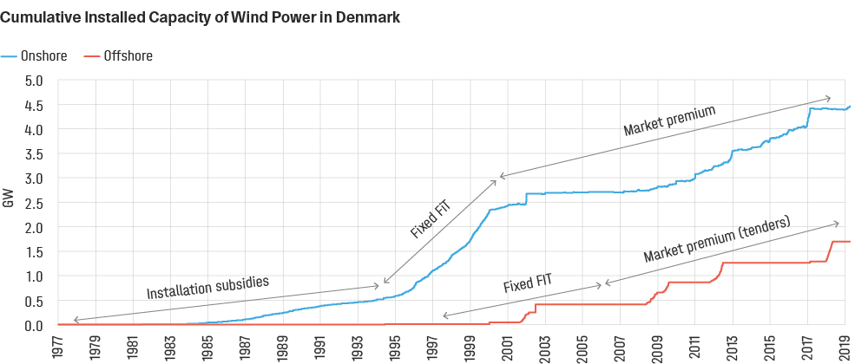
POLICY-SIDE LEARNINGS
Economic incentives
Changes through time, but importantly no retroactive changes to incentive schemes
Onshore wind grew rapidly in the 1990s in Denmark until the year 2000 saw market liberalisation, combined with reduced subsidies and low electricity prices.
Since then, the growth has resumed mainly due to replacing older turbines with newer, larger turbines.
Offshore wind turbines installed since 2004 have been through a competitive tendering procedure, whereas projects before this were demonstration projects through public-private partnerships with a Fixed FiT.
Note: the data does not include recently connected 600 MW offshore wind farm Kriegers Flak.
Notes:
Onshore wind slowed down due to:
Revised support and low electricity prices, as well as uncertainty in electricity prices
Sellers market for wind turbines and more attractive market in Germany and the UK
RECs considered but scrapped due to added uncertainties

Slide 14
POLICY-SIDE LEARNINGS
Economic incentives
Anholt
Lessons through time in auction design process for offshore wind
More information can be found here:
https://ens.dk/sites/ens.dk/files/Globalcooperation/the_danish_offshore_wind_tender_model_final.pdf
Horns Rev III
Rødsand II
Horns Rev II
Vesterhav Nord & Syd
Kriegers Flak
Source: Danish Energy Agency
Notes:
Onshore wind slowed down due to:
Revised support and low electricity prices, as well as uncertainty in electricity prices
Sellers market for wind turbines and more attractive market in Germany and the UK
RECs considered but scrapped due to added uncertainties

Slide 15
POLICY-SIDE LEARNINGS
Competition
Generators can focus on competing on generation cost
After this focus on reductions in cost, they could compete in neighbouring countries’ markets
State ownership at arm’s length in terms of decision-making was essential to not unfairly influence energy policy
This has created a vibrant competitive offshore wind industry in Denmark (3 out of 6 bidders in Thor are at least partly Danish)
Power plant package was necessary and included incentives for RE
Electricity market opens up new opportunities – balancing flexibility, heat pumps, EVs, etc
Liberalisation process told in more detail here
Notes:
Power plant package: While not all countries may have the financial
capacity for such a buyout, capital can be raised in addition
to any available funds, and cost benefit analyses can reveal
where buyouts can make the most impact.

Slide 16
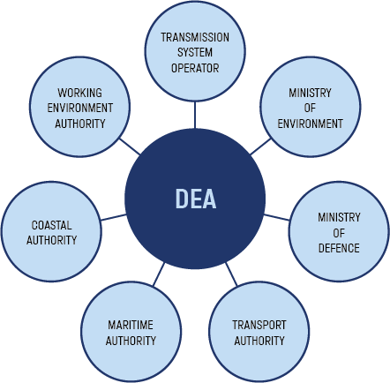
POLICY-SIDE LEARNINGS
Permitting and de-risking
The regulatory framework for offshore wind (for example) should be designed in a way so as to properly allocate risk, with the goal of attracting competition in projects to achieve the best price.
DEA acts as one-stop-shop – streamlining the consenting process, an important regulatory step to facilitate large offshore wind projects.
More information can be found here.

Slide 17
POLICY-SIDE LEARNINGS
Permitting and de-risking
De-risking offshore wind
TYPE OF RISK | OWNER | EXAMPLES
Policy commitment | Government (policy makers, government agencies) | • Credible and realistic political agreements • Certainty of targets • Sanctity of contracts
Adequate project planning and permitting risk | Developer Government agencies | • Capability of developer to plan and time the project adequately • One stop shop licensing • Environmental studies carried out at the requisite level
Construction challenges | Developer Investors | • Technical and financial capability of project owner • Competitive selection of suppliers and sub-suppliers • HSE regulation
Operational risk | Investors Insurance companies | • Cost/quality balance to be struck in desired lifetime • Adequate insurance
Offtake security and revenue support | Policy makers System operator Off-taker | • Priority access to the grid and transparent rules for curtailment • Security of income by sale of energy (market, PPA) • Revenue support
Financial and currency risk | Investors Insurance companies Government guarantees | • Asset should be tradable and transferable • Cost of the financial loan package depends on the perceived risk of the project • Capital expenditure guarantee e.g., government backed loan

Slide 18
Learnings from the energy company's business transformation
2008
2019
Creating a sustainable vision
Exit strategy for fossil fuels
Entry strategy for renewable energy

Slide 19
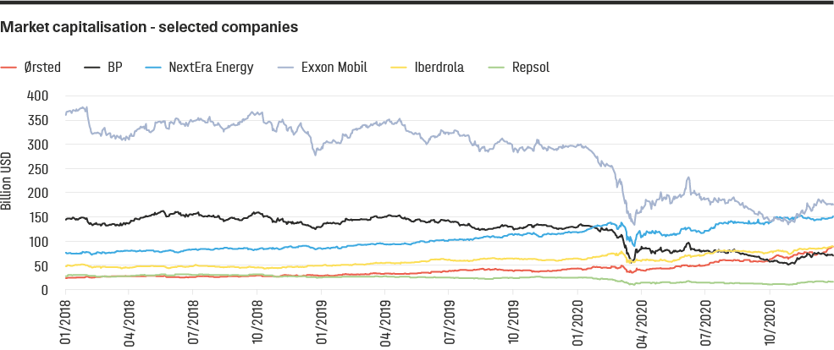
Learnings from the energy company's business transformation
Renewables overtaking their regional oil majors. Inspired by Bloomberg article, "New Energy giants are renewable companies" (Bloomberg, 2020).

Slide 20
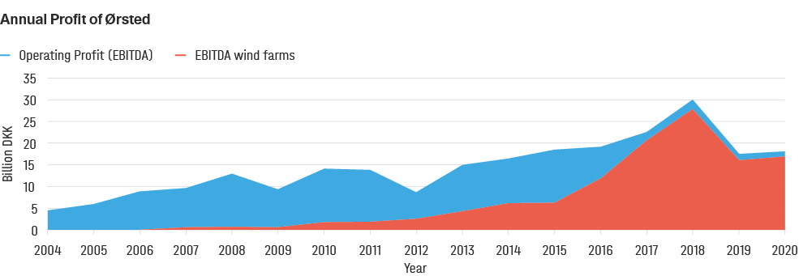
LEARNINGS FROM THE ENERGY COMPANY'S BUSINESS TRANSFORMATION
Creating a sustainable vision
Annual Operating Profit of DONG Energy / Ørsted over the years, and the share of profits from wind as a share of the total. The drop in 2019 was due to divestment.

Slide 21
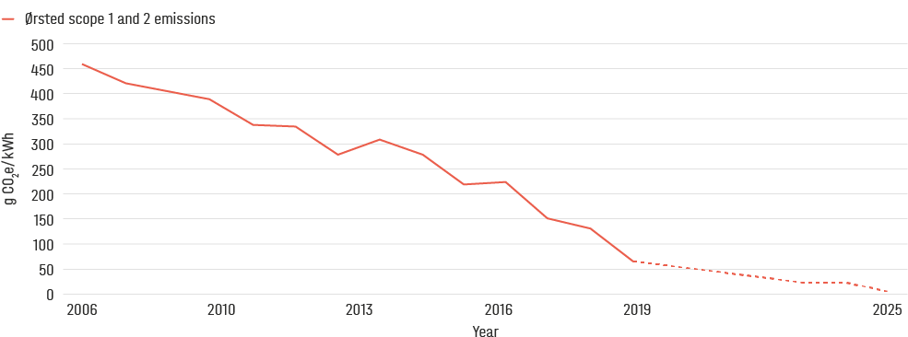
LEARNINGS FROM THE ENERGY COMPANY'S BUSINESS TRANSFORMATION
Creating a sustainable vision
Specific CO₂ emissions. Actual and prognosis. Source: Ørsted.

Slide 22
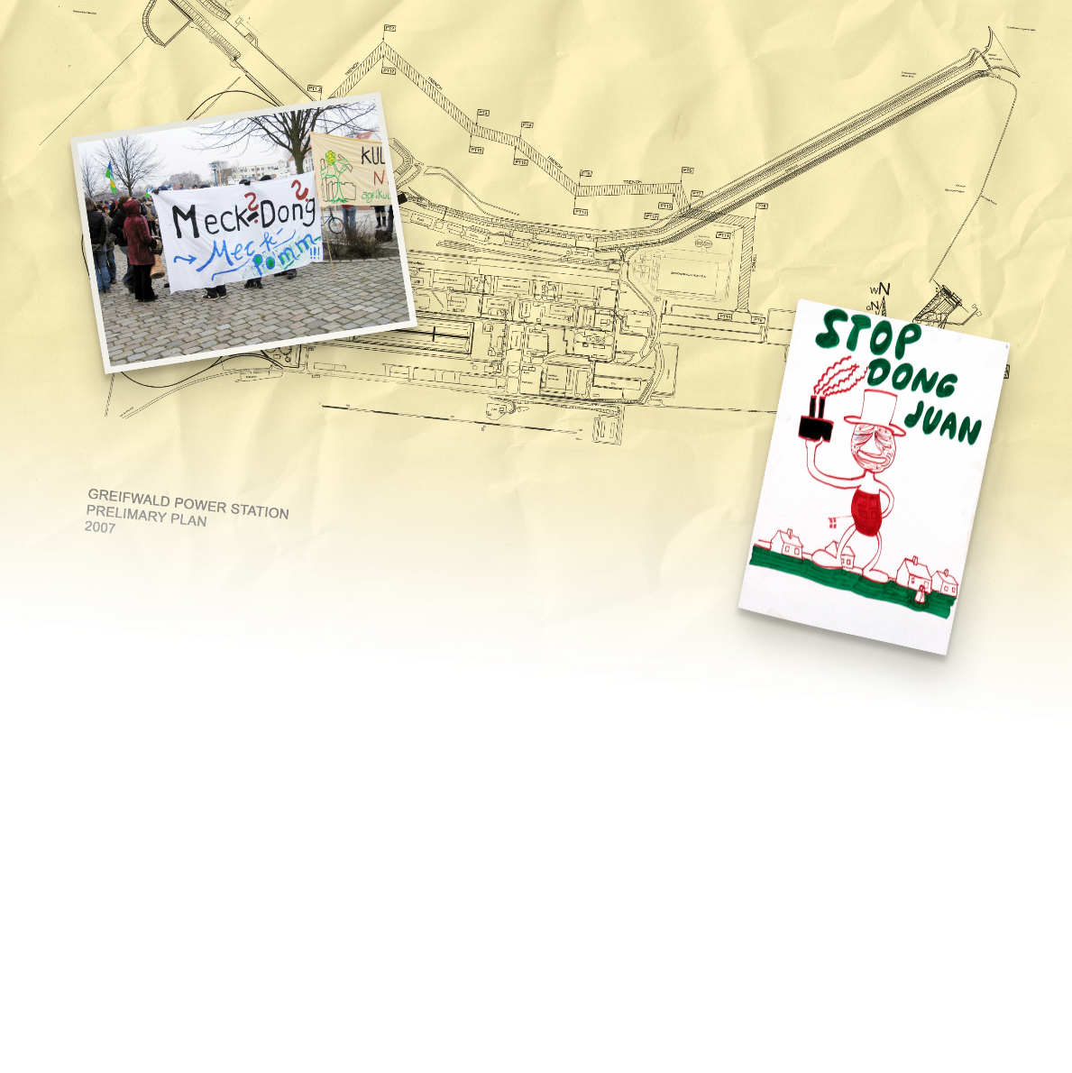
LEARNINGS FROM THE ENERGY COMPANY'S BUSINESS TRANSFORMATION
Exit strategy for fossil fuels
The exit strategy for fossil fuels at Ørsted has taken place through a number of different steps:
Closure of around 40 per cent of the company’s CHPs
A conversion to biomass with a favourable regulatory framework
Divestment of assets and businesses that do not align with the green vision, or
If all else fails, abandoned investments.
Greifswald coal-fired power station
Notes:
The transition to a competitive electricity sector included
the “power plant package” which ensured the companies
did not go bankrupt during the transition, and in return, built
offshore wind farms. This was part of negotiations with the
energy companies and the government.
For the existing coal-fired CHP plants in Denmark, as
previously mentioned, some economic incentives made
the conversion to biomass attractive, such as biomass
subsidies and tax incentives for the use of biomass as a fuel
for heating.
Danish engineers were skilled in designing and constructing
efficient coal-fired power plants. However, after Orsted
announced a strategy to phase out coal, these engineers
were either transferred internally to focus on offshore wind
(re-training), or transferred externally to consulting companies
e.g. Ramboll Engineering (re-allocation). Similarly, when
it became clear that oil and gas was not going to be a part of
the company’s future vision, the oil & gas division was sold
off to INEOS. A short overview of the development of some
of the key areas of Orsted’s business is shown below, from
2008, before the 85/15 goal was set, to 2019,
After the merger in 2006, Orsted acquired one project in Germany – a major coal-fired power plant development project
called Greifswald. From a technical perspective, the plant was not technologically risky, as the company had many experienced
and competent engineers. From a financial perspective, the business case was perhaps viable for the next 3-5 years,
but was suboptimal for the future 20-30 years. The plant also faced significant local opposition due to environmental concerns.
The project investment cost about 20 billion Danish kroner in total (approximately EUR 2.7 billion) but was abandoned
after already 1 billion Danish kroner (approximately EUR 134 million) had been spent in project development costs.
This was a learning for the company and contributed to the strategic target of completely phasing out coal by 2023.

Slide 23
LEARNINGS FROM THE ENERGY COMPANY'S BUSINESS TRANSFORMATION
What is a
decommissioning
auction?
A decommissioning auction is a financial tool employed by some EU member countries to phase out coal from the national electricity mix.
The local government organises an auction to compensate
for the decommissioning of the black asset for companies
owning and operating coal power plants. This type of
auction has been introduced both for tackling the impact
of coal on climate change targets, but also to meet halfway
with existing large coal plant operators, which are currently
struggling in the increasingly difficult market situation.
The auction is structured to award bids based on the ratio
between the asked compensation price and the resulting
reduction in CO2 emissions. In special cases, the transmission
grid operators can ask to spare some of the plants to
be used as backup capacity reserve in “critical situations”.
Nonetheless, the plants will not be allowed to participate in
the electricity market remuneration mechanisms.
Exit strategy for fossil fuels
Vattenfall abandoned a recently constructed coal-fired power plant in Germany. A decommissioning auction was facilitated by the German government

Slide 24
LEARNINGS FROM THE ENERGY COMPANY'S BUSINESS TRANSFORMATION
Entry strategy for renewable energy
Learnings in entering a new renewable energy market
Cultural shifts within the company, use of internal talent and competencies:
Supply chain as a key factor to reduce costs
Joint ventures and investor engagement

Slide 25
LEARNINGS FROM THE ENERGY COMPANY'S BUSINESS TRANSFORMATION
Follow the growth
Examples of entry and exit strategies for Ørsted, as experienced in Denmark over the last 10-15 years in particular
 | Entry strategy for renewable energy | Exit strategy for fossil fuels
Human resources | Cultural shift within the company. Build up human resources: harvest internal resources, retrain personnel, create synergies with existing base and attract new talents, increasing sustainable job opportunities. | Divest businesses that do not align with the new green vision
Technology strategy | Develop and test proof of concept projects, devise long term strategies with ambitious targets and scale up large-scale renewable projects. Then choose technologies based on their return and risk profile in a given regulatory framework, investigating the impact on players in the supply chain. Bring the technology to cost-competitive levels with the existing products, assessing the role of the new product in existing and new markets. | Convert directly, e.g., coal to biomass The same could be done with existing coal power plants, by using the land for hybrid solar and wind projects and re-using the existing transmission infrastructure.
Market forces & project choices | Invest in new projects. Joint ventures can be a good way to gain technical experience and knowledge, filling the gap with the missing technical competences to reach the objective. Institutional, national and international investors can be attracted to green projects with long-term returns and low risk. Investors and technical advisors which have been educated about the new technology and the mission are more likely to feel confident in approving co-investments. | Abandon projects Several coal-fired power plants have been abandoned in northern Europe as they are no longer profitable and attract public opposition.

Slide 26
Recommendations
NATIONAL ENERGY PLANS
CONCRETE LEGISLATIVE REFORMS
A NEW GREEN COMPANY VISION
EXIT STRATEGY FOR FOSSIL FUELS
ENTRY STRATEGY FOR RENEWABLE ENERGY

Slide 27
RECOMMENDATIONS
National Energy Plans
Long term
Transparent
Stable
Inclusive

Slide 28
RECOMMENDATIONS
Concrete legislative reforms
Economic incentives
Reforms to ensure an electricity sector based on competition
Demonstration projects
Permitting and de-risking

Slide 29
RECOMMENDATIONS
A new green company vision
Make good use of the long-term planning policies in place
Contextualise the strategy
Develop a holistic vision within the dynamic landscape

Slide 30
RECOMMENDATIONS
Exit strategy for fossil fuels
Engage actors and government agencies in the divestment plans
Re-evaluate the asset to fit the future of the sector
Abandon investments when regulations and public opposition hinder future opportunities

Slide 31
RECOMMENDATIONS
Entry strategy for renewable energy
Attract finance to new renewable energy projects validating the proof of concept
Engage, align and educate stakeholders
Be a first mover: enjoy the benefits and be ready for the challenges
Value joint ventures: share the skills
Build up human resources: harvest internally, retrain personnel, create synergies with existing base and attract new talents

Slide 32
RECOMMENDATIONS
Transitioning from black to green energy
A NEW GREEN COMPANY VISION
NATIONAL ENERGY PLANS
Make good use of the long-term planning policies in place
Contextualise the strategy
Develop a holistic vision within the dynamic landscape
Long term
Transparent
Stable
Inclusive
CONCRETE LEGISLATIVE REFORMS
EXIT STRATEGY FOR FOSSIL FUELS
Economic incentives
Reforms to ensure an electricity sector based on competition
Demonstration projects
Permitting and de-risking
Engage actors and government agencies in the divestment plans
Re-evaluate the asset to fit the future of the sector
Abandon investments when regulations and public opposition hinder future opportunities
ENTRY STRATEGY FOR RENEWABLE ENERGY
Attract finance to new renewable energy projects validating the proof of concept
Engage, align and educate stakeholders
Be a first mover: enjoy the benefits and be ready for the challenges
Value joint ventures: share the skills
Build up human resources: harvest internally, retrain personnel, create synergies with existing base and attract new talents

